Slide 1
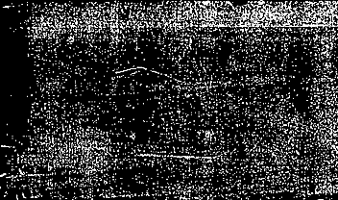

Matthew 24
The Signs of the Times

Slide 2
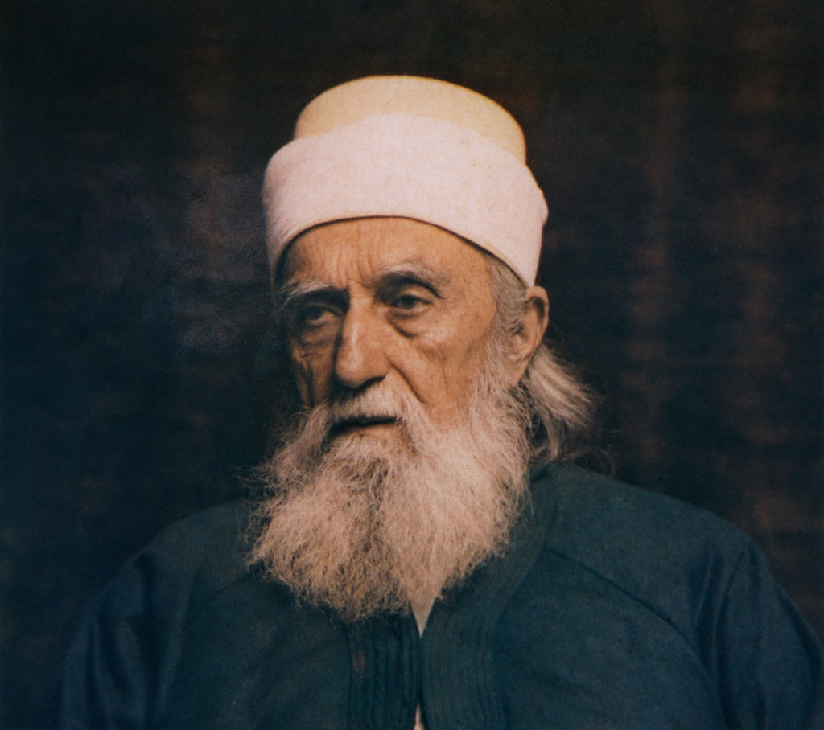
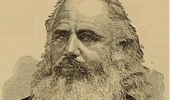
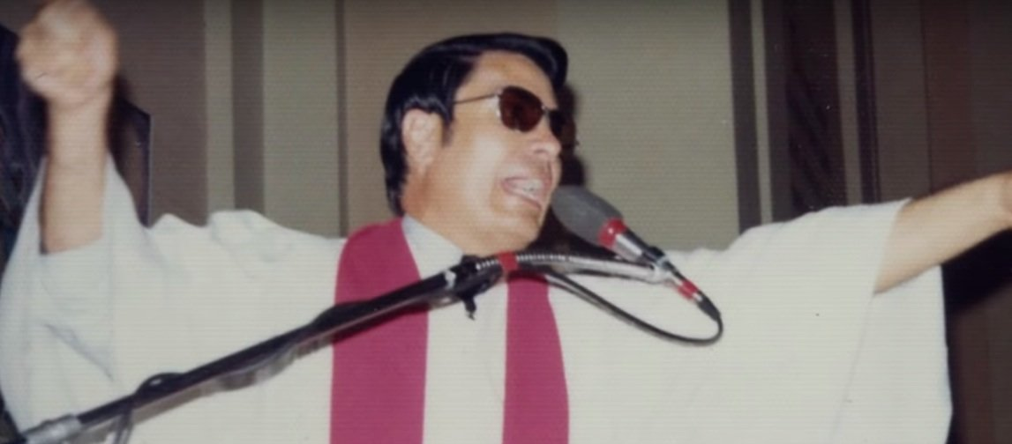
Antichrist
Revelation 13:4-6, Revelation 13:11-15

Slide 3

ANTICHRIst
Bahá'u'lláh (1817–1892), born Shiite, adopted Bábism later in 1844. He claimed to be the prophesied fulfillment and Promised One of major religions including Hinduism, Judaism, Zoroastrianism, Buddhism, Christianity and Islam.
William W. Davies (1833–1906), leader of a Latter Day Saint schismatic group called the Kingdom of Heaven in Washington from 1867 to 1881. He taught his followers that he was the archangel Michael, who had previously lived as the biblical Adam, Abraham, and David. When his son Arthur was born in 1868, Davies declared that the infant was the reincarnated Jesus Christ. When Davies's second son, David, was born in 1869, he was declared to be God the Father.
Jim Jones (1931–1978), founder of Peoples Temple, which started off as an offshoot of a mainstream Protestant sect before becoming a personality cult as time went on. He claimed to be the reincarnation of Jesus, Akhenaten, the Buddha, Vladimir Lenin and Father Divine in the 1970s. He organized a mass murder suicide at Jonestown, Guyana on November 18, 1978. He shot himself after the murders were done.
Oscar Ramiro Ortega-Hernandez (b. 1990). In November 2011, he fired nine shots at the White House in Washington D.C., believing himself to be Jesus Christ sent to kill U.S. President Barack Obama, whom he believed to be the antichrist.

Slide 4

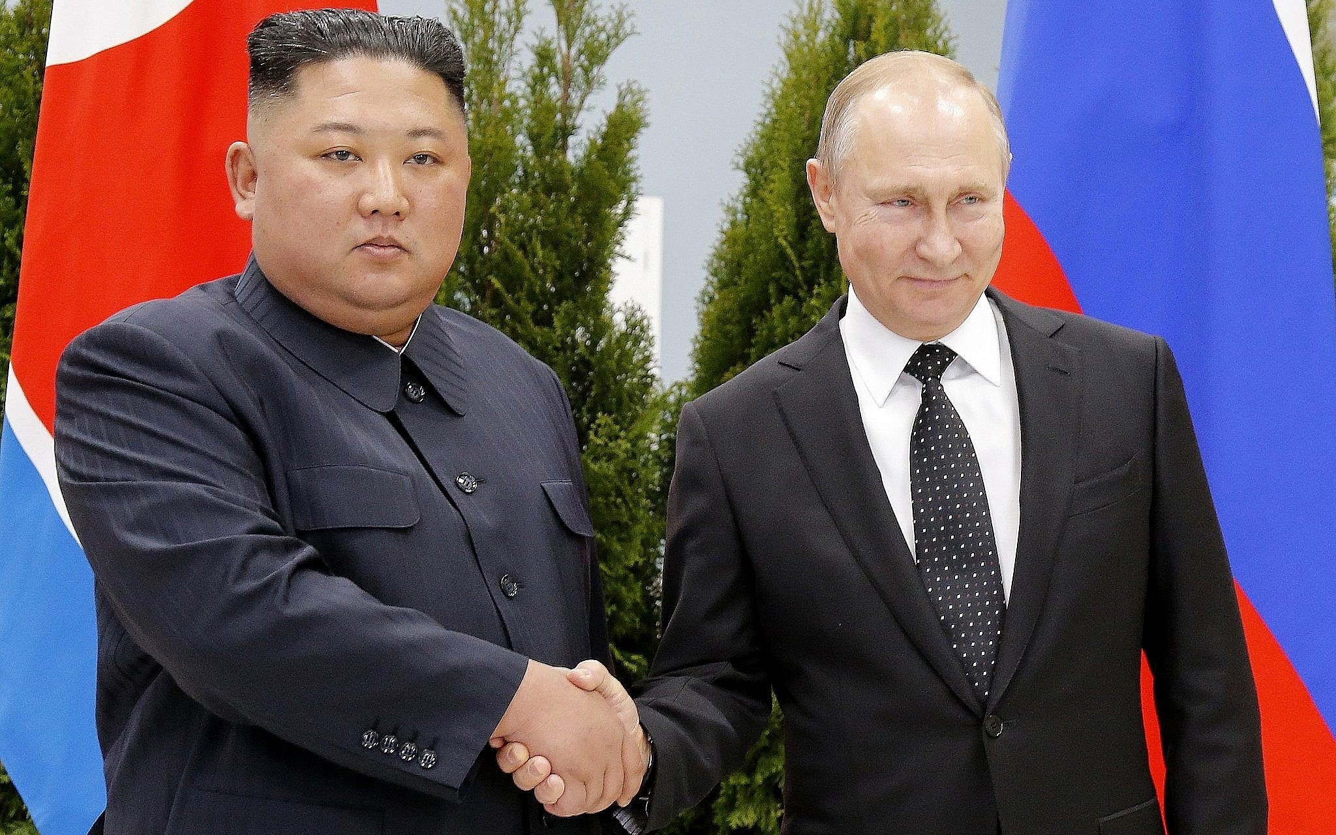
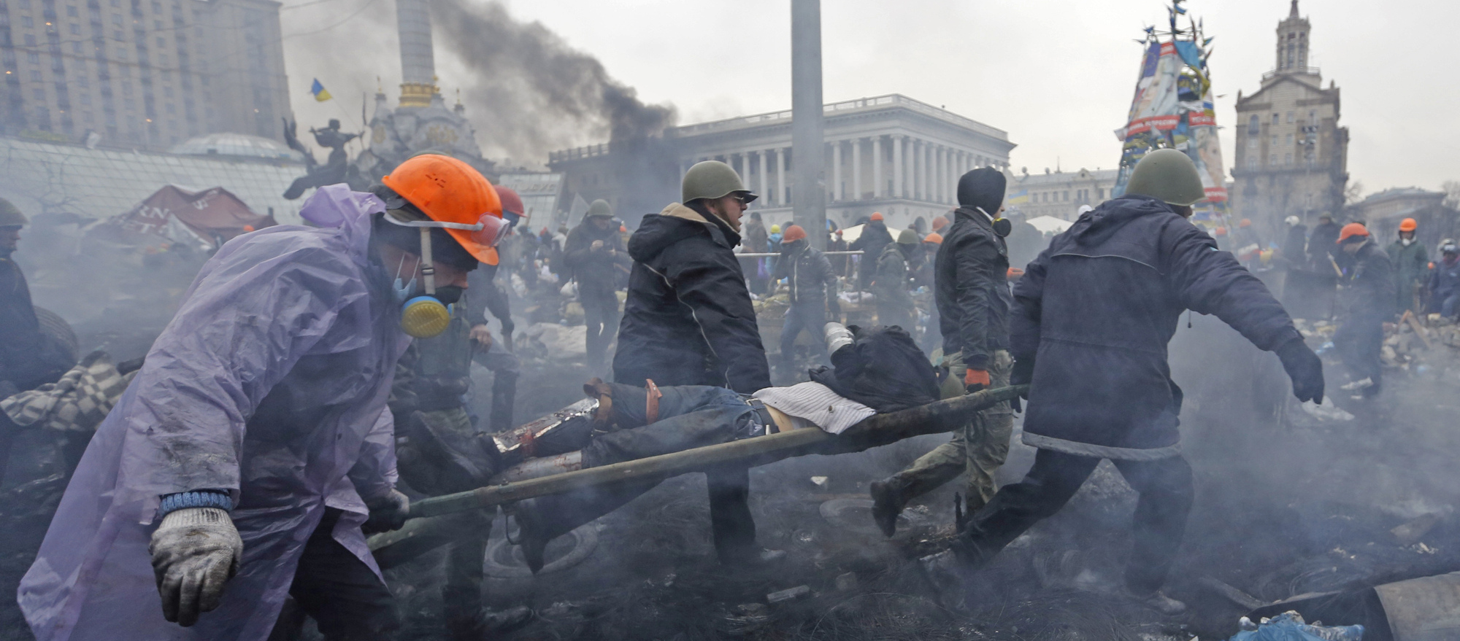
War
Ezekiel 7:15, 1 Samuel 4:1-11, Revelation 12:7-11, 13:7-8

Slide 5
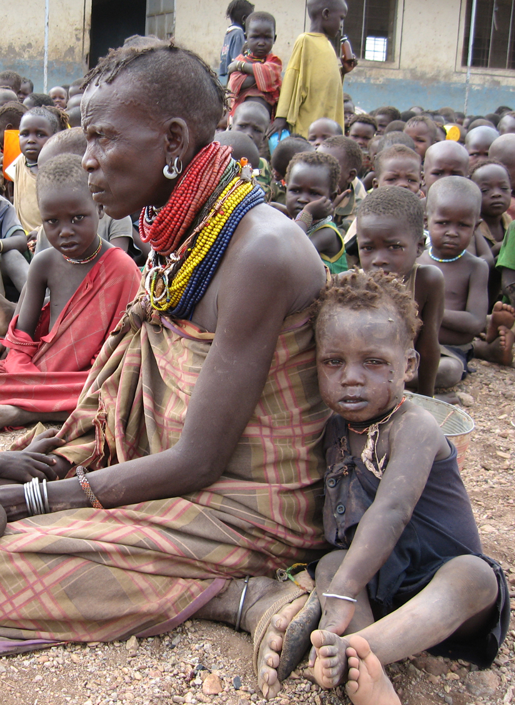
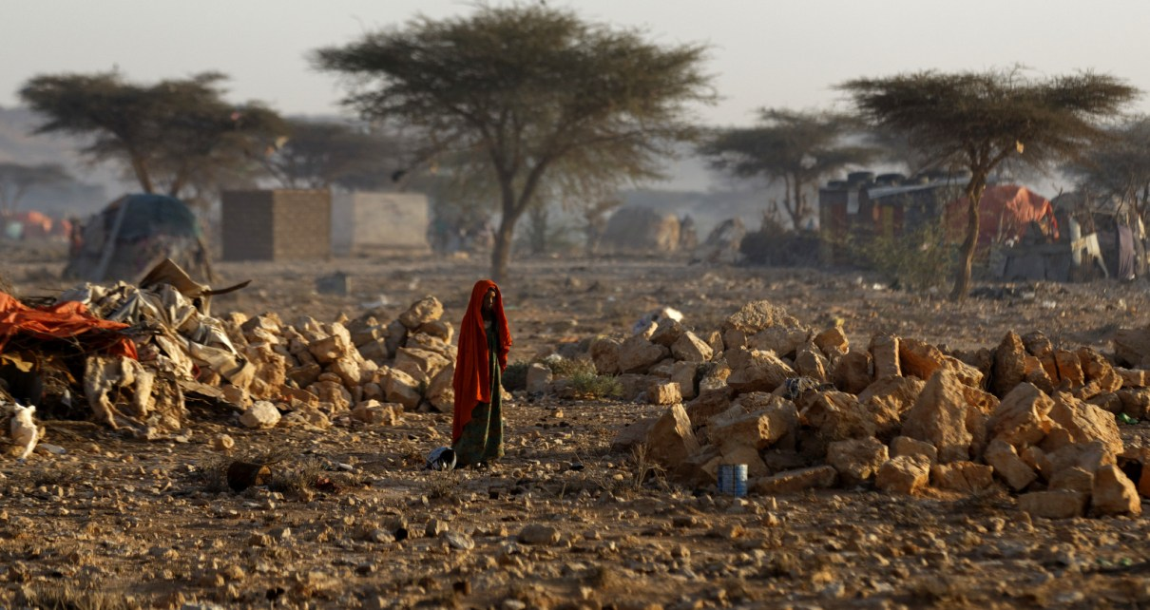
Famine
2 Kings 6:25-31, Ezekiel 7:15, Revelation 18:8

Slide 6

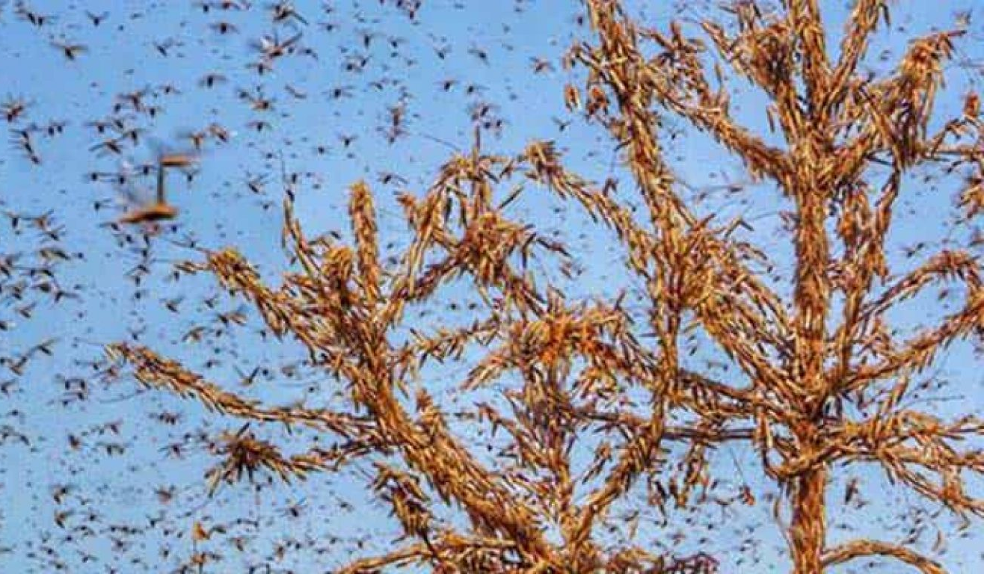
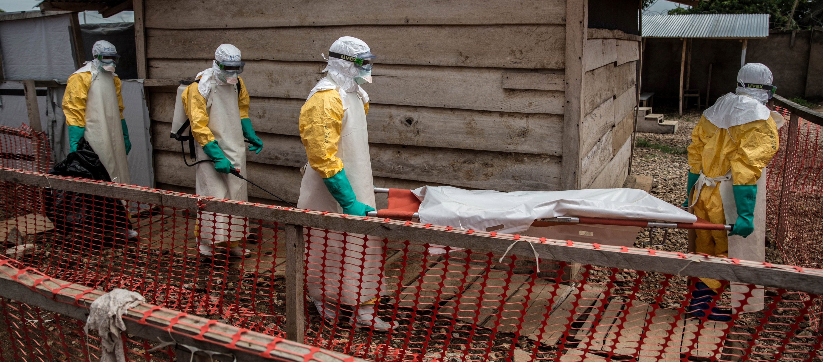
Pestilence
Exodus 10:13-15, Numbers 21:5-6, Revelation 16:21

Slide 7
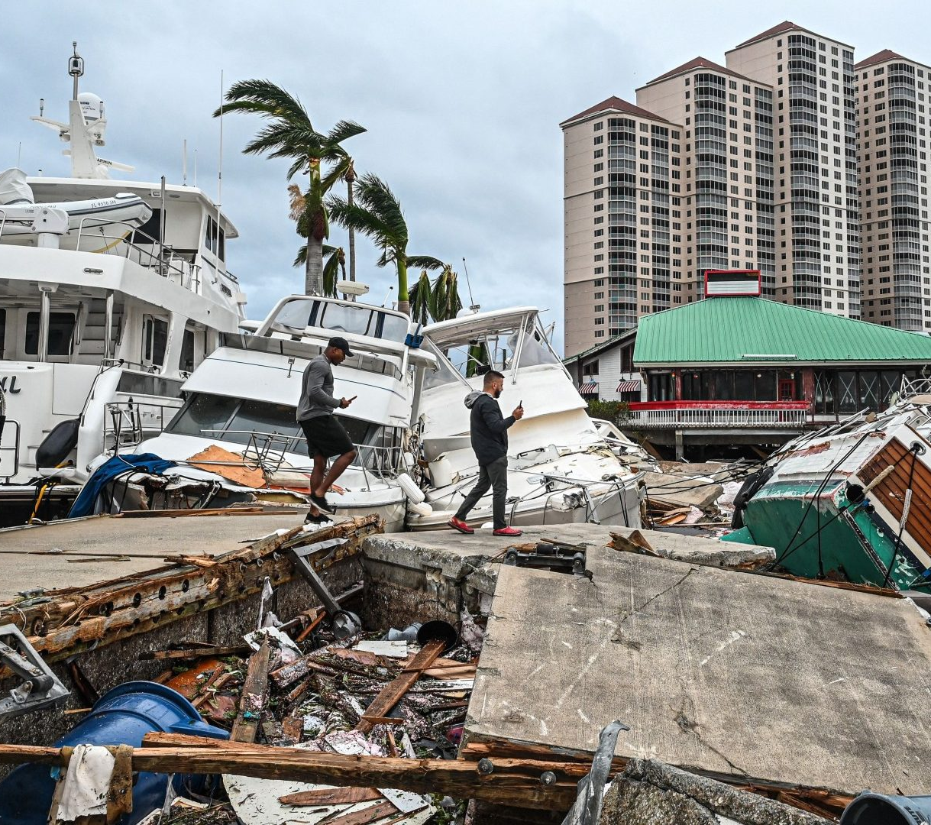
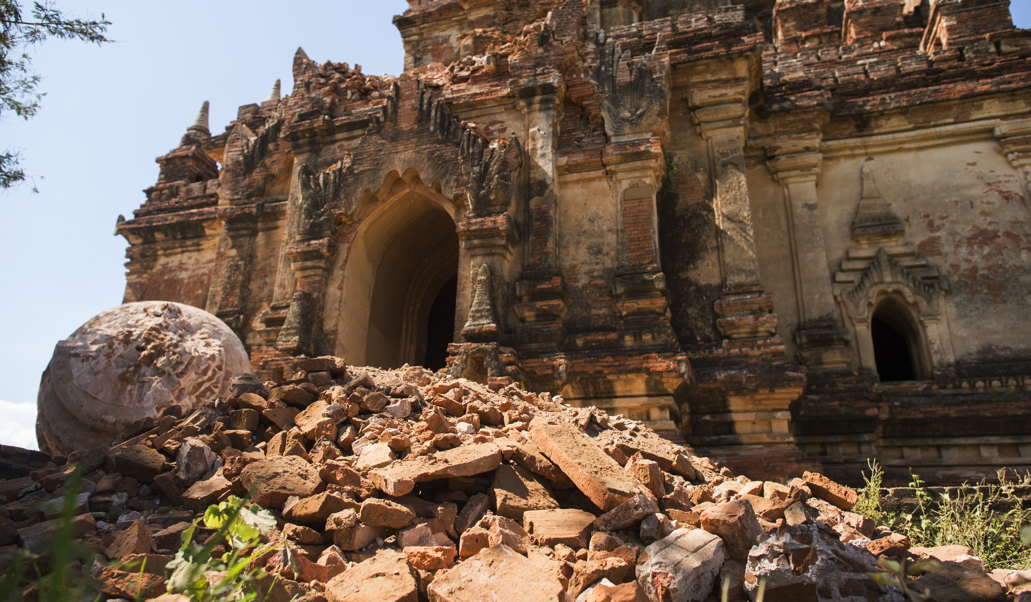
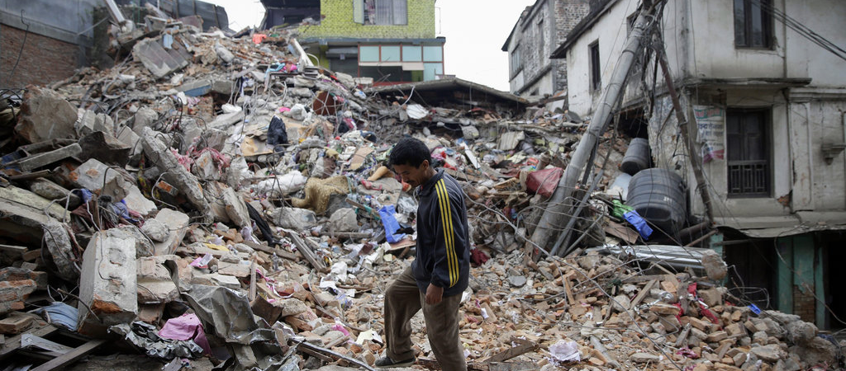
Earthquake
Matthew 27:50-51, Revelation 16:18-20

Slide 8
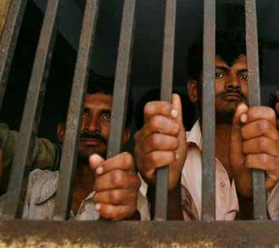
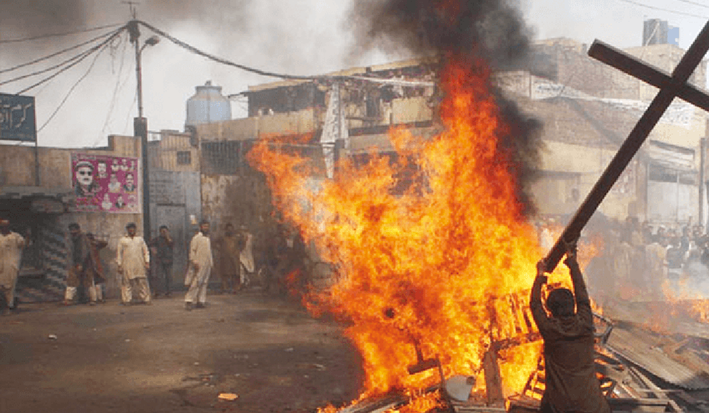
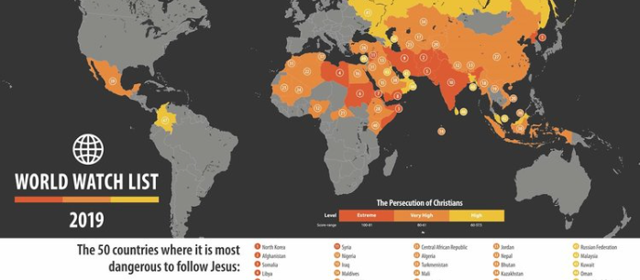
Persecution and Betrayal
2 Chronicles 36:17-21, Matthew 14:3‭-‬11, 26:14-16, 48-50, Revelation 13:15

Slide 9
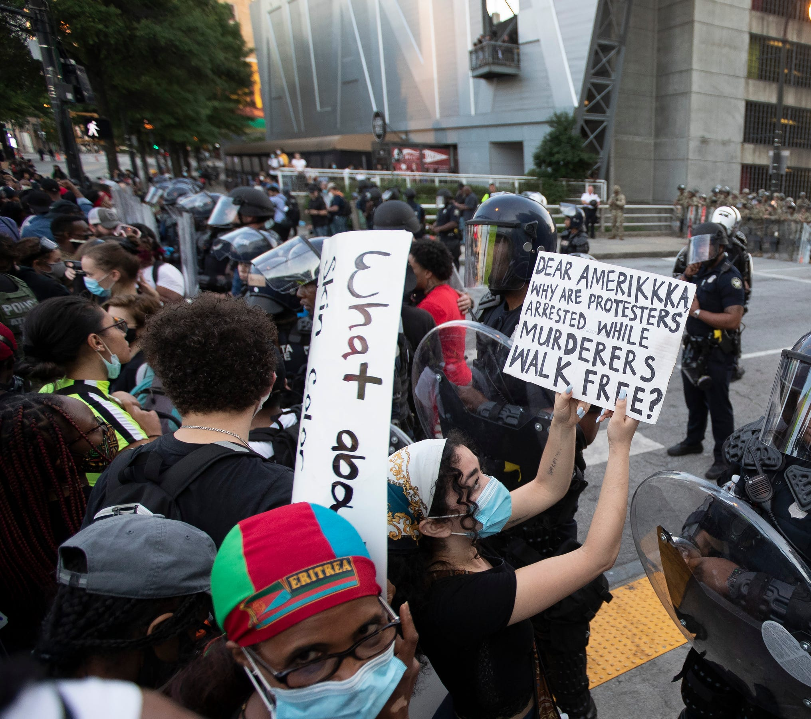
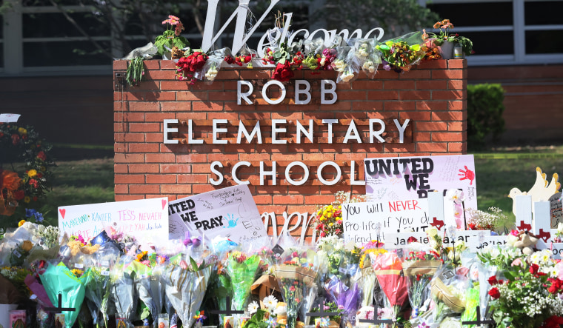
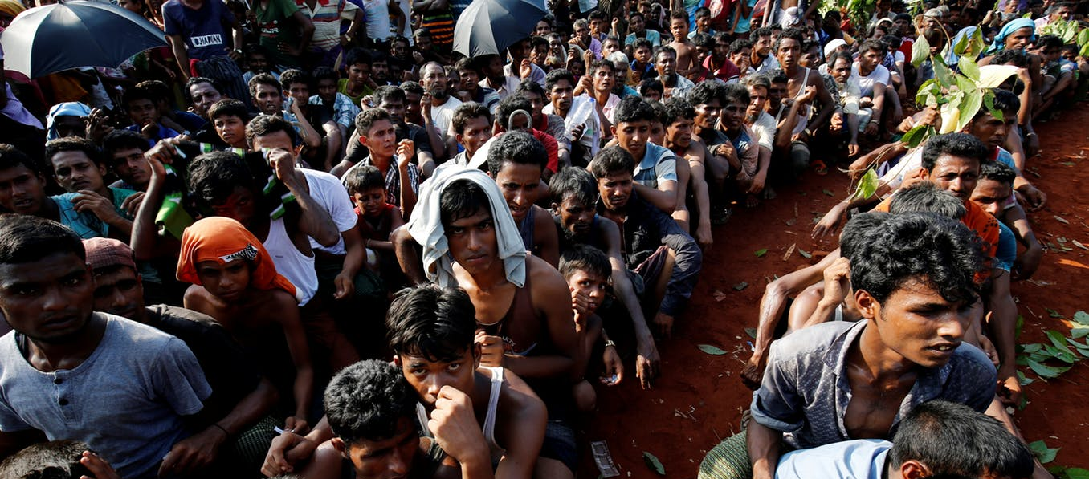
Hatred
Matthew 24:9-10, Nehemiah 4:1-5, Revelation 13:11-15

Slide 10
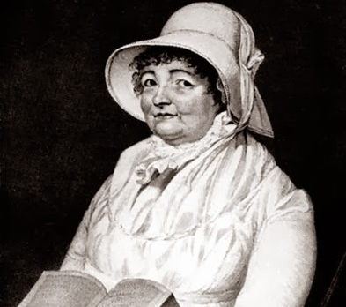
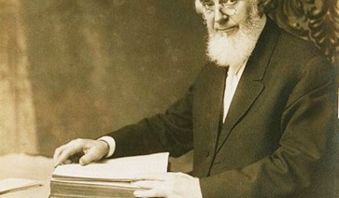
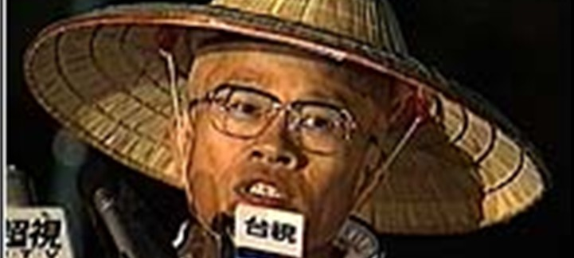
False Prophets
Matthew 24:11, 2 Chronicles 18:4-11, 16-22, Revelation 13:12-14

Slide 11
False Prophets
Taiwanese religious leader Hon-Ming Chen established Chen Tao, or True Way, a religious movement that blended elements of Christianity, Buddhism, UFO conspiracy theories, and Taiwanese folk religion. Chen preached that God would appear on U.S. television channel 18 on March 25, 1988, to announce that he would descend to Earth the following week in a physical form identical to Chen. The following year, he prophesized, millions of devil spirits, together with massive flooding, would result in a mass extinction of the human population. Followers could be spared by buying their way aboard spaceships, disguised as clouds, sent to rescue them.
Joanna Southcott - In 1813, she announced that in the following year she would give birth to the second messiah, whose arrival would signal the last days of the Earth—despite being 64 years old and, as she told her doctors, a virgin. She died before a baby could be born.
Charles Taze Russell, founder of Jehovah's Witness, predicted the world would end in October 1914 or October 1915, whichever one proved to be correct.

