Slide 1
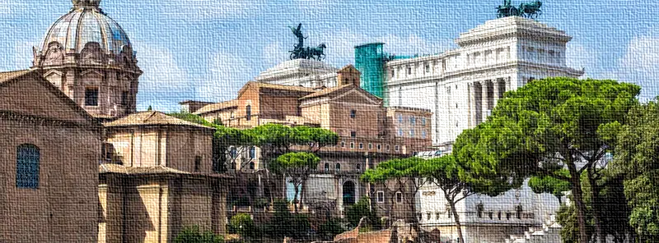
The Epistles of Peter
Bible study
Photo By: Colourbox

Slide 2
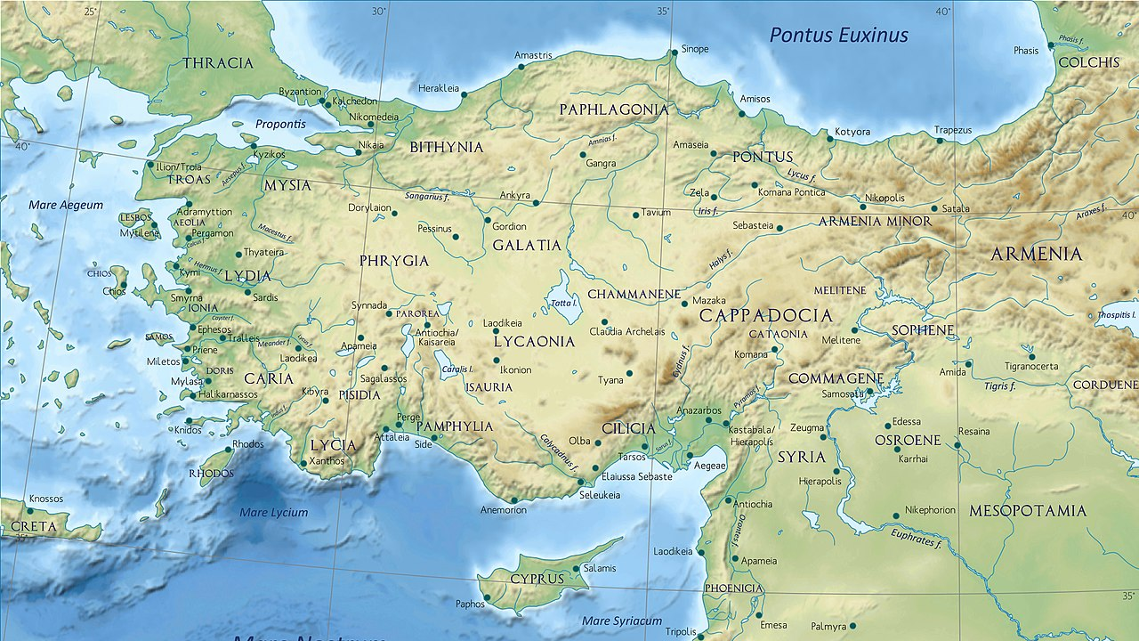
1 Peter 1
written to the “strangers” in Pontus, Galatia, Cappadocia, Asia, and Bithynia
Photo By:
Wikipedia

Slide 3
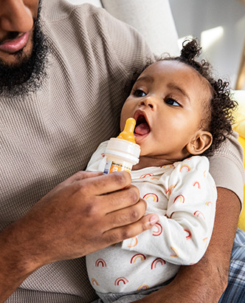
1st Peter 2
v2: As newborn babes, desire the sincere milk of the word, that ye may grow thereby:
What exactly does milk do for babies?
  contains a unique mix of fatty acids, lactose, amino acids, vitamins, minerals, enzymes, and other important factors
  supports easy digestion, brain development, and protection from illness and infections
  allows sufficient intake of calcium, vitamin D and fat
Photo By: Fastly

Slide 4
1st Peter 2
v12: Having your conversation honest among the Gentiles: that, whereas they speak against you as evildoers, they may by your good works, which they shall behold, glorify God in the day of visitation.
What does “your conversation” include?
  actions and behavior
  speech and language
What are some real-world examples of Gentiles speaking against us?
  COVID-19 pandemic
    many reports about Christians spreading the virus by meeting in churches

Slide 5


1st Peter 2
v13-14: Submit yourselves to every ordinance of man for the Lord's sake: whether it be to the king, as supreme; Or unto governors, as unto them that are sent by him for the punishment of evildoers, and for the praise of them that do well.
What exactly should we be obeying?
  Ephesians 6:1 → obedience to any authority figure must be “in the LORD”
Photos By: CNN, BBC

Slide 6
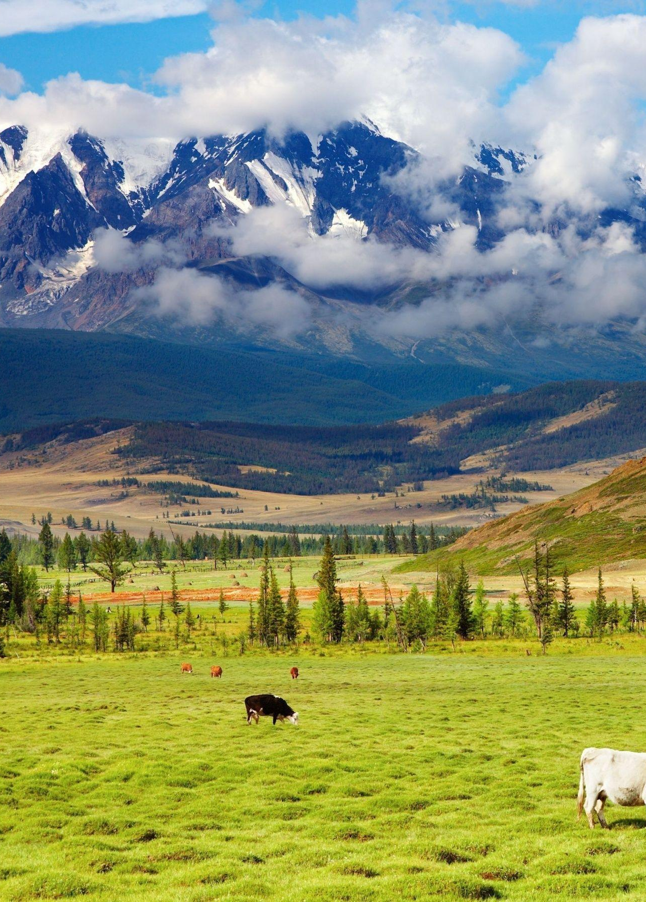
1st Peter 2
v15-16: For so is the will of God, that with well doing ye may put to silence the ignorance of foolish men: As free, and not using your liberty for a cloke of maliciousness, but as the servants of God.
We must use the freedom from death that we have through CHRIST to spread his message freely.
  Through this freedom, we don’t have to fear death because we are assured that we will be saved after death.
  Don’t use this freedom to commit sin and then repent half heartedly.
Photo By: Wallpaper Access

Slide 7

1st Peter 2
v19-v20: For this is thankworthy, if a man for conscience toward God endure grief, suffering wrongfully. For what glory is it, if, when ye be buffeted for your faults, ye shall take it patiently? but if, when ye do well, and suffer for it, ye take it patiently, this is acceptable with God.
At jobs, schools, etc., endure suffering, mocking, and jeering, even if its unwarranted or unfair → longsuffering
  this shows WHO is in you & demonstrates the ignorance of your oppressors
    Proverbs 25:21-22
v23: Who, when he was reviled, reviled not again; when he suffered, he threatened not; but committed himself to him that judgeth righteously:
Romans 12:19
Photo By: Get2Growth

Slide 8
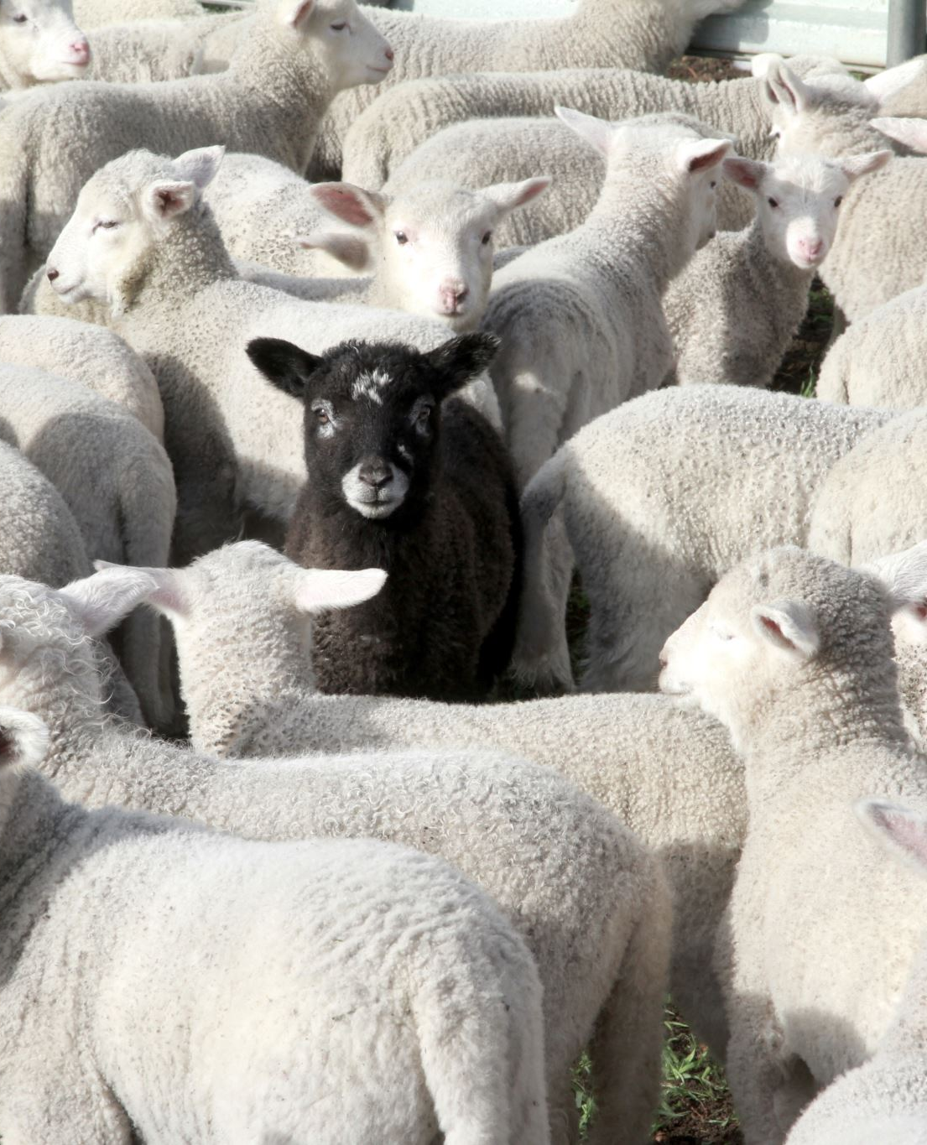
1st Peter 2:25
For ye were as sheep going astray; but are now returned unto the Shepherd and Bishop of your souls.
Why does a sheep leave its flock?
  likely showing early signs of illness
  may simply be lost
Photo By: Quizlet

Slide 9
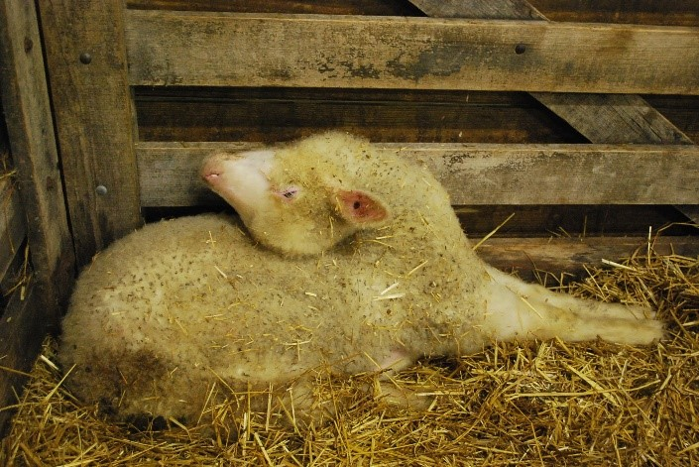
Polioencephalomalacia (CCN)
most common in weaned lambs (4-8 months) but also occurs in adult sheep
during the early stages of CCN affected sheep are blind and become isolated from the group and may wander aimlessly
without treatment, death follows within 3 to 5 days
Photo By: On Pasture

Slide 10
1st Peter 3
v1-v7: our relationships with others (wives, husbands, brethren)
v8-v17: our walk as believers (suffer for righteousness, seek peace, control the mouth)
v18-v22: For Christ also hath once suffered for sins, the just for the unjust, that he might bring us to God, being put to death in the flesh, but quickened by the Spirit: By which also he went and preached unto the spirits in prison; Which sometime were disobedient, when once the longsuffering of God waited in the days of Noah, while the ark was a preparing, wherein few, that is, eight souls were saved by water. The like figure whereunto even baptism doth also now save us (not the putting away of the filth of the flesh, but the answer of a good conscience toward God,) by the resurrection of Jesus Christ: Who is gone into heaven, and is on the right hand of God; angels and authorities and powers being made subject unto him.

Slide 11
1st Peter 4
v2-v6: we must abstain from the lusts of the flesh
v7-v11: our walk as believers (be watchful, have charity, spread GOD’s word)
v12-v19: we must endure tribulation
    (v12) Beloved, think it not strange concerning the fiery trial which is to try you, as though some strange thing happened unto you:
      What does this remind us of?

Slide 12
1st Peter 5
v1-v5: instructions for specific groups (Church leaders, youth)
  (v2) Feed the flock of God which is among you, taking the oversight thereof, not by constraint, but willingly; not for filthy lucre, but of a ready mind;
    leaders in the church should not be in it for the money…

Slide 13
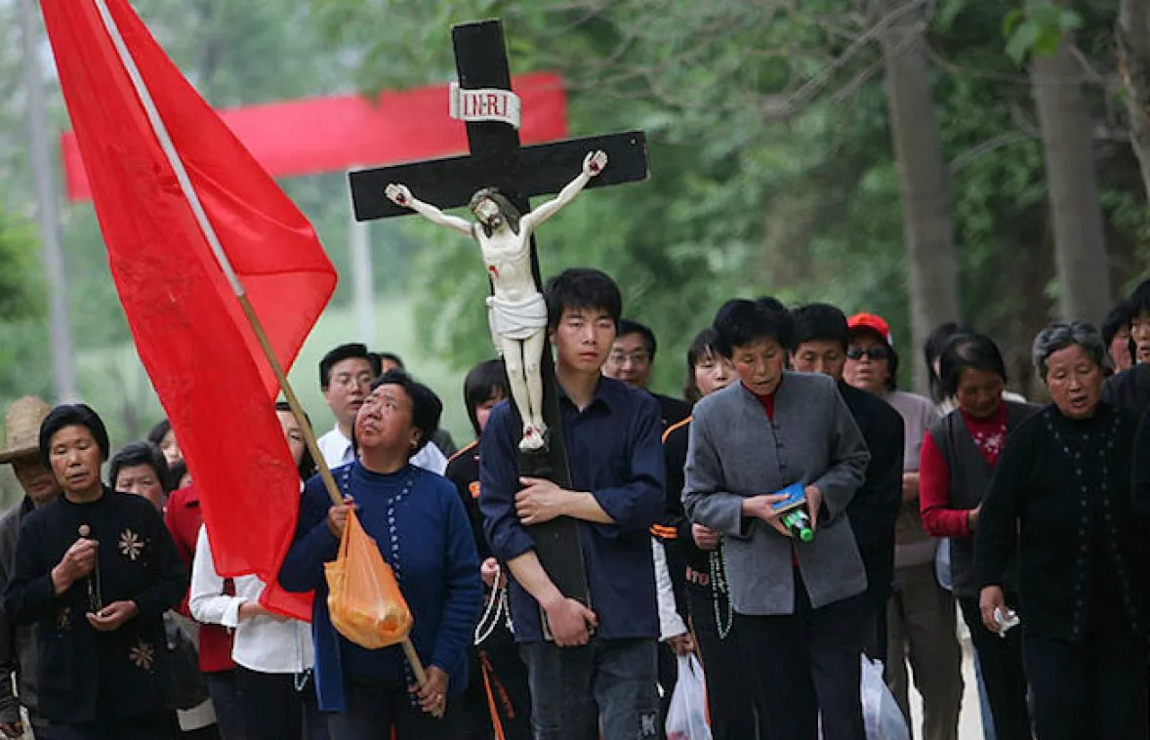
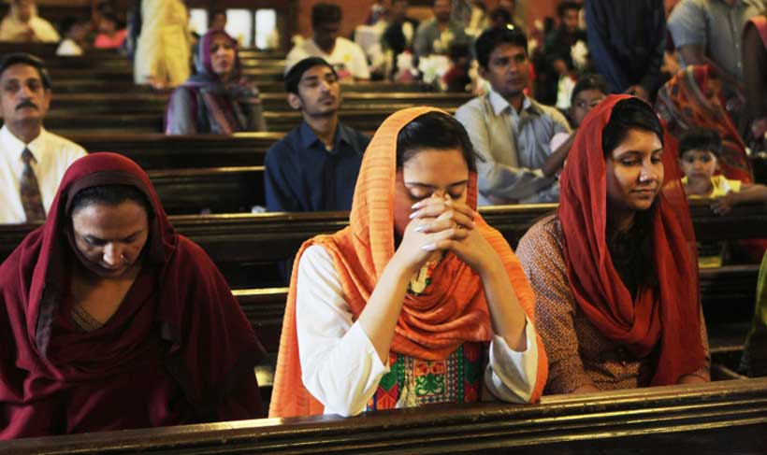
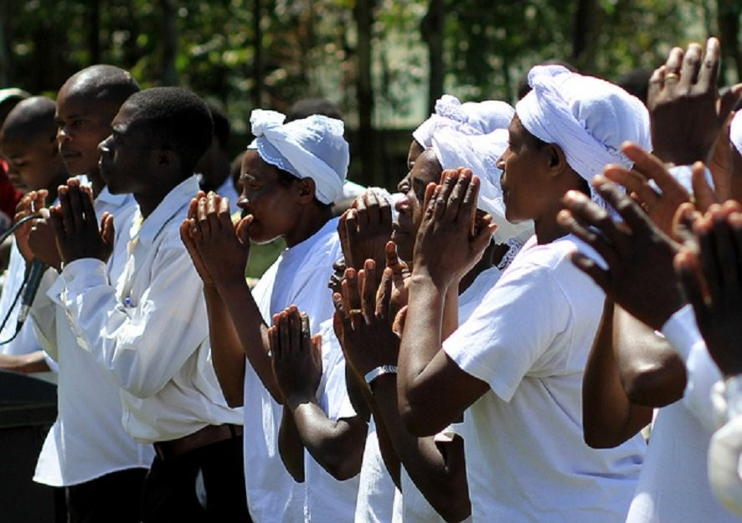
1st Peter 5
v6-v11: how we as believers should be behaving
  be humble
  rely on GOD
  be sober and vigilant
  resist the devil
  think of our brethren throughout the world
Photos By: Foreign Policy, American Pakistan Foundation, Flickr

Slide 14
2nd Peter 1
Faith
Virtue
Godliness
Knowledge
Temperance
Patience
Brotherly Kindness
Charity
v5-v7: And beside this, giving all diligence, add to your faith virtue; and to virtue knowledge; And to knowledge temperance; and to temperance patience; and to patience godliness; And to godliness brotherly kindness; and to brotherly kindness charity.

Slide 15
2nd Peter 2
v1-v2: But there were false prophets also among the people, even as there shall be false teachers among you, who privily shall bring in damnable heresies, even denying the Lord that bought them, and bring upon themselves swift destruction. And many shall follow their pernicious ways; by reason of whom the way of truth shall be evil spoken of.
What false teachings are out there today?
  Every Christian is guaranteed wealth and good health.
  Only certain people can be saved (bases of race, ethnicity, etc.).
  Christians can’t interact with/talk to unbelievers (Pharisaical viewpoint).

Slide 16
2nd Peter 2
v3: And through covetousness shall they with feigned words make merchandise of you: whose judgment now of a long time lingereth not, and their damnation slumbereth not.
v10: But chiefly them that walk after the flesh in the lust of uncleanness, and despise government. Presumptuous are they, selfwilled, they are not afraid to speak evil of dignities.
This describes those who are against decency and order (1 Corinthians 14:40)
v13: And shall receive the reward of unrighteousness, as they that count it pleasure to riot in the day time. Spots they are and blemishes, sporting themselves with their own deceivings while they feast with you;
v19: While they promise them liberty, they themselves are the servants of corruption: for of whom a man is overcome, of the same is he brought in bondage.
v22: But it is happened unto them according to the true proverb, The dog is turned to his own vomit again; and the sow that was washed to her wallowing in the mire.

Slide 17
2nd Peter 3
v3-v4: Knowing this first, that there shall come in the last days scoffers, walking after their own lusts, And saying, Where is the promise of his coming? for since the fathers fell asleep, all things continue as they were from the beginning of the creation.
v8-v10: But, beloved, be not ignorant of this one thing, that one day is with the Lord as a thousand years, and a thousand years as one day. The Lord is not slack concerning his promise, as some men count slackness; but is longsuffering to us-ward, not willing that any should perish, but that all should come to repentance. But the day of the Lord will come as a thief in the night; in the which the heavens shall pass away with a great noise, and the elements shall melt with fervent heat, the earth also and the works that are therein shall be burned up.

