Slide 1




Representatives of CHRIST
Photo By:
Suncoast Weddings
Being The Bride

Slide 2
Introduction
As believers, we are representatives of CHRIST.
In this presentation, we will study about how we as females can be representatives of CHRIST and representatives of our home.

Slide 3


PHYSICAL
Representatives of Our Home
Photo By:
Shine365

Slide 4
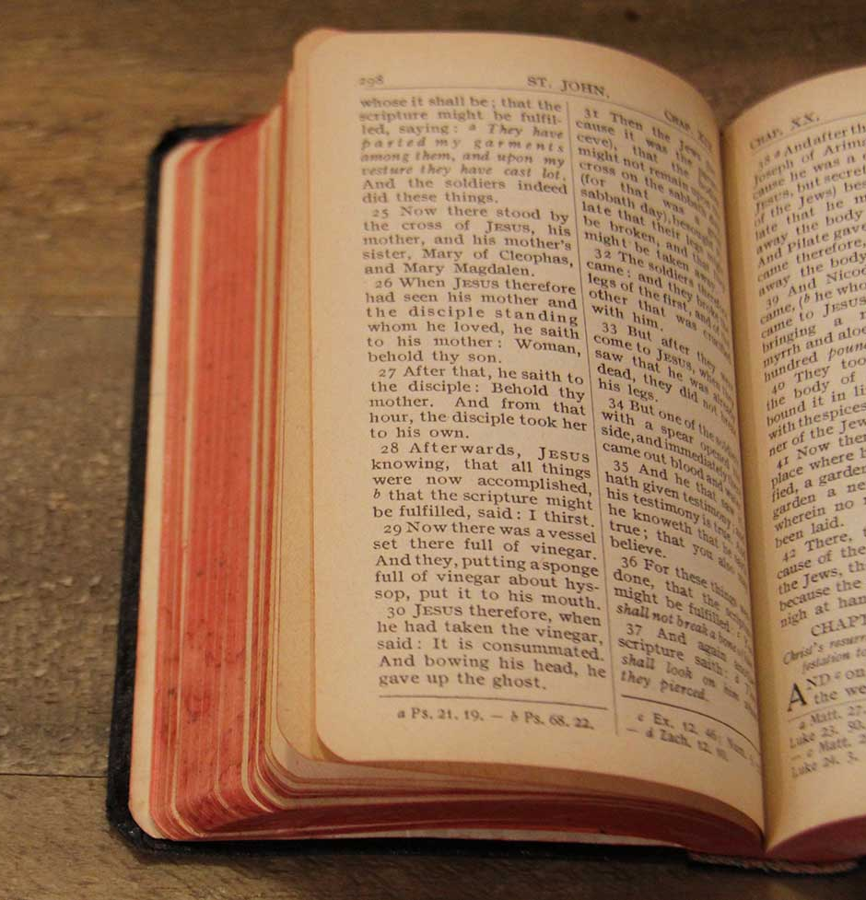
REPRESENTING THE HOME
Why is representing your home properly important?
There are many biblical examples that show people representing their home.
Genesis 9:20-25
Luke 2:46-49
Genesis 39:1-6
Esther 2:15-17
In the above examples, some were good examples, while others were poor examples.
Being a poor example may bring shame to your home, but it’s even worse in a believing home because it misrepresents GOD and can turn people away from HIS truth (Romans 2:13-24).
Photo By: Big Dream Ministries

Slide 5



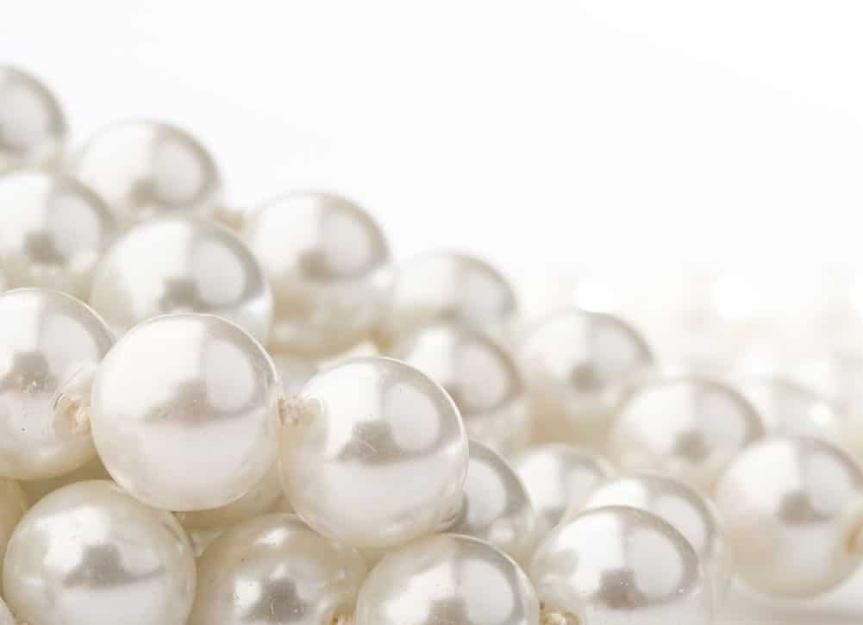
APPAREL
Photo By:
Jewelry Gossips
1 Timothy 2:9 – dress properly.
We must dress modestly. We should not lower our worth just to impress a man. Instead, we must dress ourselves with good works.
Photo By: The Pearl Source Blog

Slide 6



DAUGHTERS
Photo By: wallup
Photo By: flickr
Representing the Home
Photo By: wallup

Slide 7
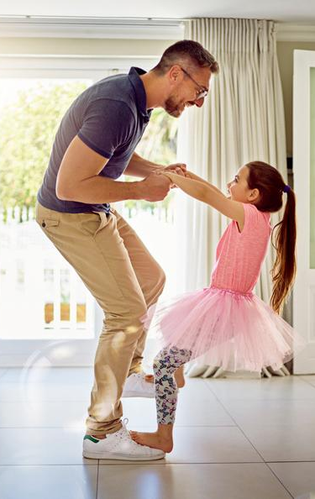
DAUGHTERHOOD
How can a daughter properly represent her home?
Ephesians 6:1-2, Colossians 3:20 – be obedient.
Matthew 19:14 – seek GOD’s face.
2 Kings 2:23-24 – be respectful.
Proverbs 17:25, Proverbs 23:24-25 – be wise.
1 Timothy 2:11-12 – learn in silence. What does this mean?
Do not try to seize authority from GOD’s appointed leaders.
Photo By: Parent Map

Slide 8


DAUGHTERHOOD
Photo By:
De Econometrist
Challenges to Overcome:
Peer pressure/fear of rejection
Provoking parents
How can a daughter overcome these challenges?
Proverbs 1:10, 2 Corinthians 6:17-18
Ephesians 6:4
1 Thessalonians 5:17
Photo By: Smart Parents

Slide 9


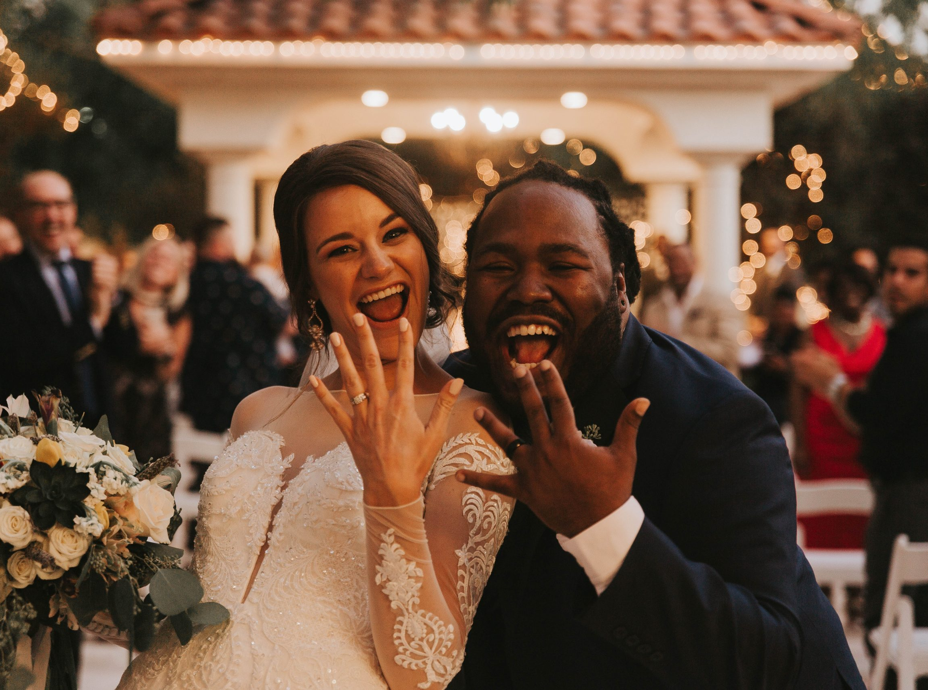
WIVES
Photo By: Pixnio
Representing the Home
Photo By: Pexels
Photo By: OpenOregon

Slide 10

WIFEHOOD
How can a wife properly represent her home?
Proverbs 31:10-31 – count the cost, love her husband, be wise, provide for the household, work hard for the good of the family.
Ephesians 5:22-24, Colossians 3:18 – submit to your husband.
1 Timothy 2:11-12 – learn in silence.
Photo By: Today

Slide 11

WIFEHOOD
Challenges to Overcome:
A divided home
Illness
How can a wife overcome these challenges?
1 Thessalonians 5:17
James 5:16
Photo By: Working Women of Faith

Slide 12


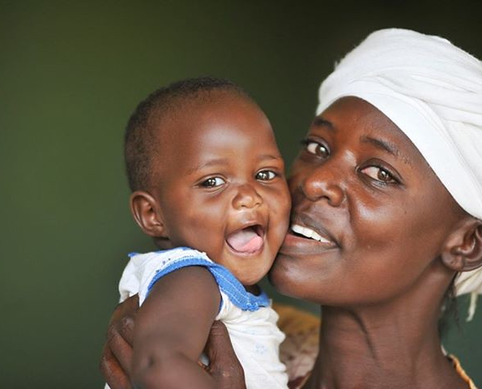
MOTHERS
Photo By: Hindustan Times
Photo By: Bloomers and Bows
Representing the Home
Photo By:
flickr

Slide 13

MOTHERHOOD
How can a mother properly represent her home?
Proverbs 31 – be a Proverbs 31 woman.
John 16:21, Psalms 127:3 – love/be grateful for her children.
Proverbs 22:6 – raise her children properly.
1 Timothy 2:11-12 – learn in silence.
Photo By: WallpaperCave

Slide 14


MOTHERHOOD
Photo By: Medical Daily
Challenges to Overcome:
Illness
Disobedient children
Outside influences
How can a mother overcome these challenges?
1 Thessalonians 5:17
Proverbs 22:6
Proverbs 23:13-14
Photo By: Parent Map

Slide 15

SPIRITUAL
Photo By: theTrumpet
Representatives of CHRIST

Slide 16

BEING A CHILD OF GOD
How can we be proper representatives of CHRIST?
Matthew 22:36-40
We are known for our love.
Photo By: FreeImages

Slide 17
SCRIPTURES
As ambassadors and children of the KING, we must do ministry, be separate from the heathen, and witness.
There are key scriptures that describe how we as representatives of CHRIST must conduct ourselves.
Ephesians 4:17-32
1 Timothy 4:12, 16
Acts 18:28
1 John 3:18

Slide 18



THE END
Photo By: Michigan.gov
Photo By: wellmune
Photo By:
iStock

