Slide 1
Photo By:
Stuart Luce

Slide 2
Introduction
Without opening the bible ask yourself these questions:
What do you know about Genesis? What kind of book is it?
Who wrote the book of Genesis?
What famous stories are found in Genesis?
What questions can you formulate from the book of Genesis?
Why is Genesis important to us?
The Book of Genesis (Greek: Γένεσις, "birth", "origin") or Bereshith (Hebrew: בְּרֵאשִׁית, "in the beginning") is the first book of the Hebrew Bible, and the first of five books of the Torah, called the Pentateuch in the Christian Old Testament.
Historical Christianity taught that the entire Pentateuch, the five books from Genesis to Deuteronomy, was written by Moses.
Most Fundamentalist and other Evangelical Christians continue to follow this belief.
Most liberal and mainline theologians and religious skeptics accept the Documentary Hypothesis: the Pentateuch was written by several authors from four different traditions, and who imported some material from nearby Pagan sources.
In this presentation, we will be looking into each chapter of The Book of Genesis.

Slide 3
GENESIS
Chapter 1

Slide 4
The Creation Story; Genesis 1:1 - 2:3
Photo By:
Christianity Malaysia

Slide 5
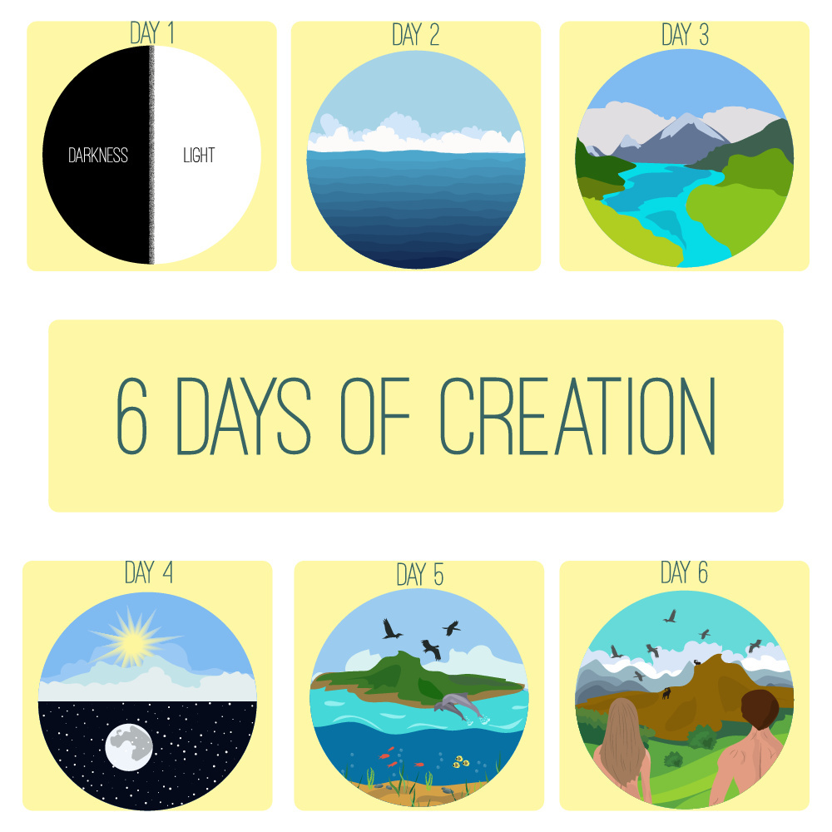
The Days of Creation
Day 1: creation of light and its separation from darkness.
Day 2: separation of the sky and oceans.
Day 3: separation of land from the oceans; spreading of plants and grass and trees across the land.
Day 4: Creation of the sun, moon, and stars.
Day 5: Creation of sea animals and birds.
Day 6: Creation of the land animals. Creation of humanity.
Day 7: God rested.
Followers of the Documentary Hypothesis believe this to have been a later addition, placed there to give theological justification for the Sabbath (Saturday as a day of rest).
Photo By:
Christian Publishing House Blog

Slide 6
Common Creation Questions
Light was listed as being created on day 1, but its source (the sun and stars) did not appear until day 4.
Most creation scientists, who generally support the literal interpretation of this creation story, have a solution to this puzzle. Many say that light initially came from GOD, before he created the sun and stars. This inference is supported by various scriptures including 2 Corinthians 4:6, 1 John 1:5 and Revelation 21:23.
Birds were said to be created before other land animals. Paleontologists, who almost universally support the theory of evolution, point out that the fossil record shows the opposite order.
Creation scientists discount this belief. Most regard the rock layers containing the fossil record as having been laid down during the flood of Noah; thus, the fossils do not represent the evolution of the species of animals and birds. The possibility of these layers forming during the flood is likely because water is key in forming sedimentary rock, the rock that fossils are found in. So, as the water covered the animals, sedimentary rock may have formed, preserving the fossils. Furthermore, birds can be found higher up in the fossil record which supports the scripture, because the flood waters rose over time, first covering land animals and then birds.
Photo By:
Free PNGimg

Slide 7
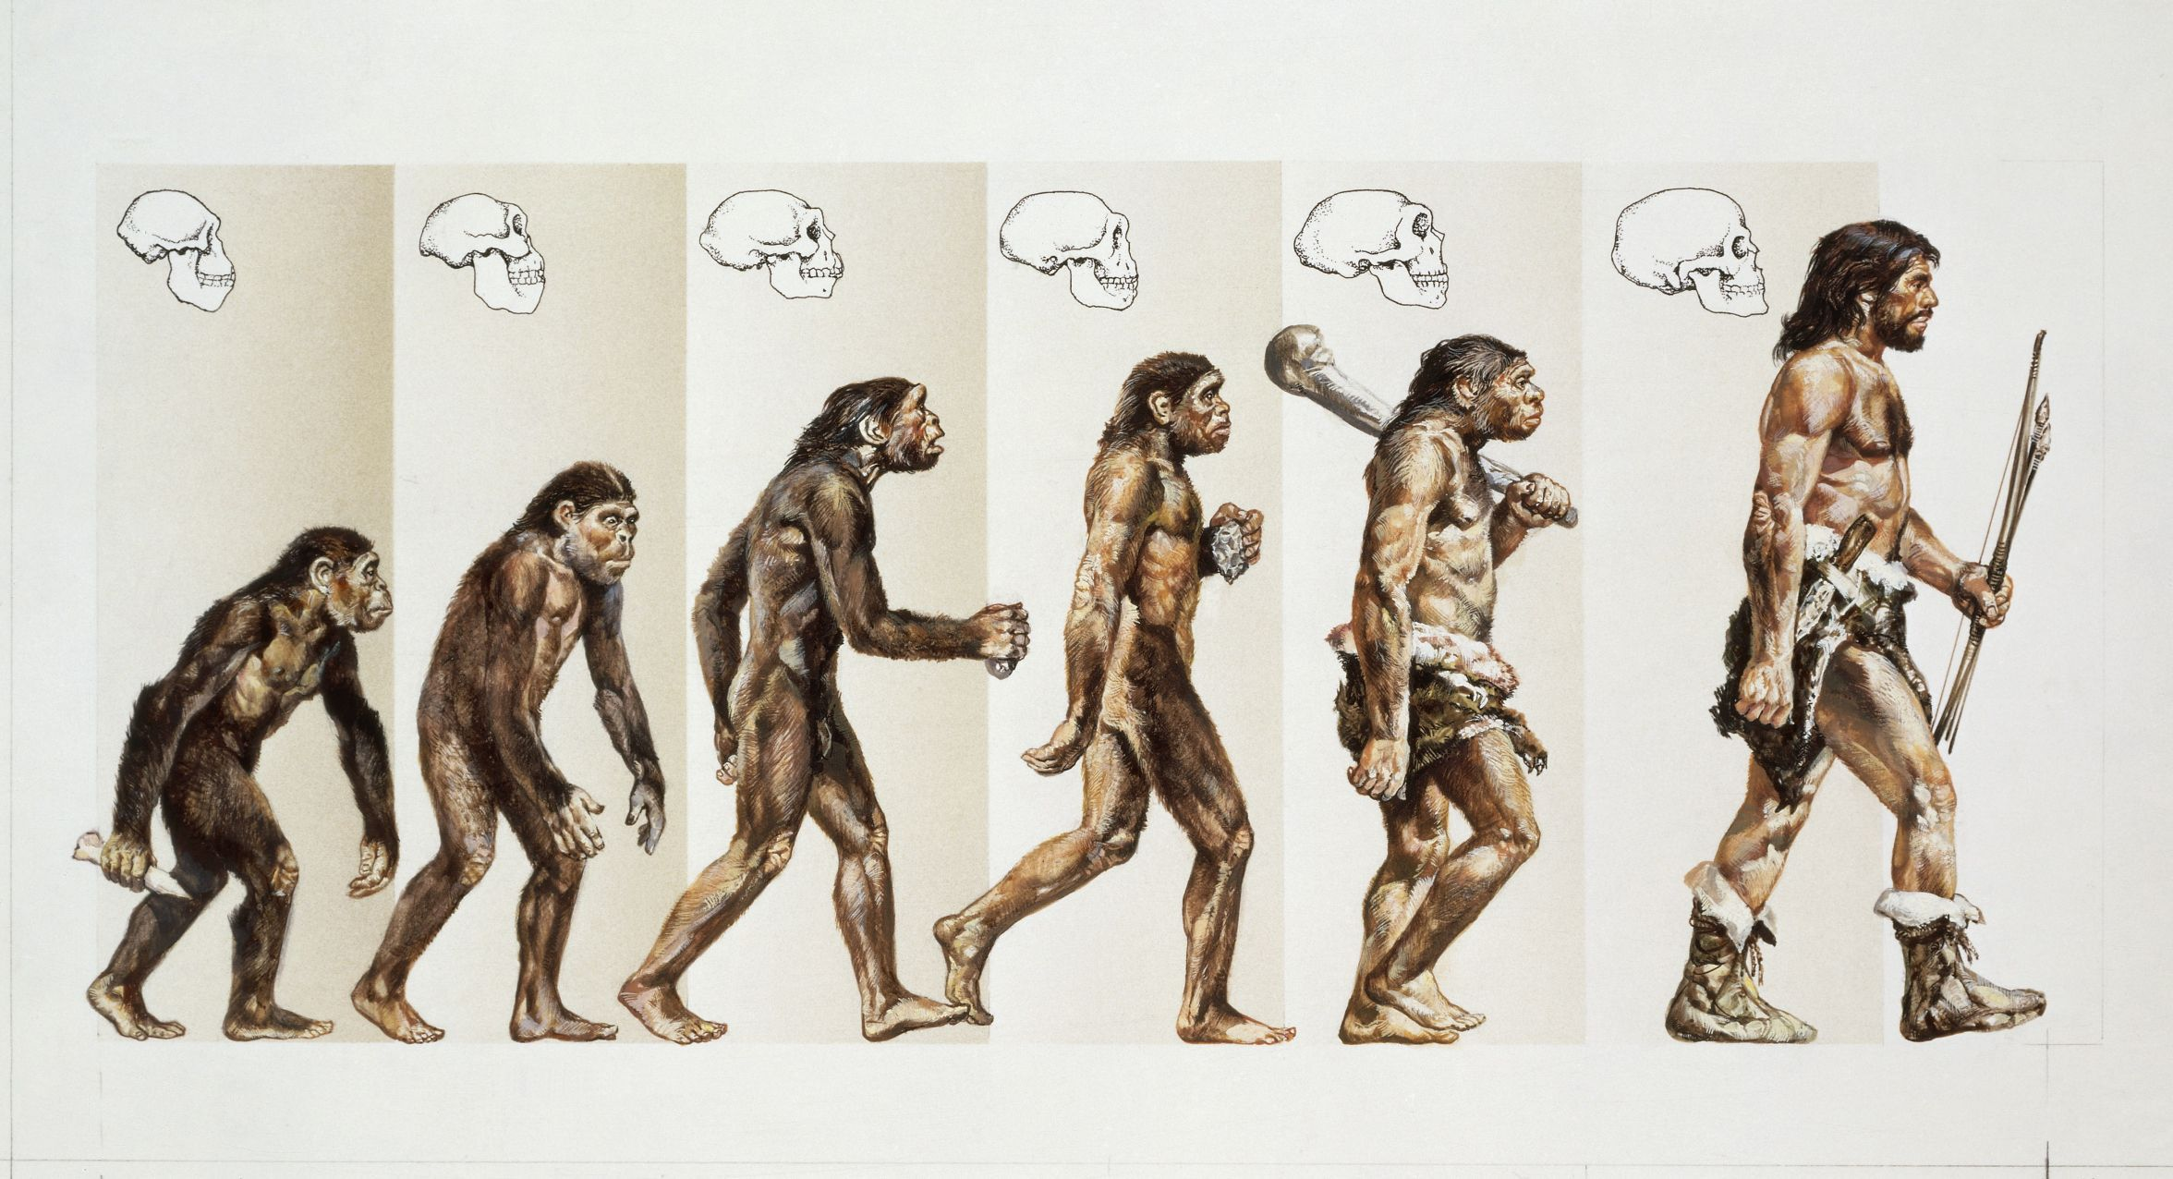
Common Creation Questions
The most controversial debate over this creation story relates to its time span. Genesis 1 and 2 explains how the creation of Earth's life forms, the Earth itself, and the rest of the universe took six days. However, supporters of the theory of evolution argue that the universe has been evolving for about 14 billion years.
Many people have tried to place a gap of indeterminate time between the first two verses of Genesis chapter 1 with something called “The Gap Theory”.
There are many different versions as to what supposedly happened in this “gap” of time. Most versions of the “gap” theory place millions of years of geologic time (including billions of fossil animals) in between these two first verses of Genesis. This is the “ruin-reconstruction” version of the gap theory. However, this undermines the gospel as it allows for death, bloodshed, disease, and suffering before Adam's sin. Because most “ruin-reconstruction” theorists have accepted the millions of years dating for the fossil record, they have thus allowed the fallible theories of scientists to determine the meaning of Scripture.
Some put the fall of Satan in this supposed period. But any rebellion of Satan during this gap of time contradicts God's description of His completed creation on day six as all being “very good” (Genesis 1:31).
All versions of the gap theory impose outside ideas on Scripture and thus open the door for further compromise.
Photo By:
ThoughtCo.

Slide 8
Common Creation Questions
Scientific theories claim that the universe is billions of years old, but the scripture states otherwise.
The simple answer to this supposed contradiction is that faith must be applied here. Obviously, no one living today, except GOD, was around at the foundation of the world. Truly, HE is the only one that we can rely on for definite answers to that question.
It can also be argued that the scientific methods for determining the Earth’s are not reliable, as they are flawed and have been proven to fail. Examples of this are carbon dating, tree rings, etc.
Therefore, both beliefs require a measure of faith and we as believers must simply have faith in GOD.
Photo By:
ThoughtCo.

Slide 9
GENESIS
Chapter 2

Slide 10
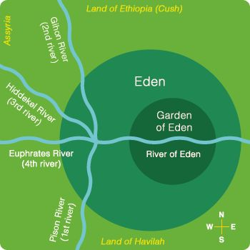
Genesis 2: The Four Rivers
Pison means "increase"
1) one of the four rivers used to describe the location of the garden of Eden
Gihon means "bursting forth"
1) one of the four rivers of the Garden of Eden
2) a spring near Jerusalem where the anointing and proclaiming of Solomon as king took place
Hiddekel means "rapid"
1) one of the rivers of Eden which coursed east toward Assyria; better known as the Tigris
Euphrates means "fruitfulness"
1) the largest and longest river of western Asia; rises from two chief sources in the Armenian mountains and flows into the Persian Gulf
Photo By:
Pinterest

Slide 11
Genesis 2: A Few Firsts
Man’s First Command
The first command for man was given by GOD.
Man’s first command is found in Genesis 2:16-17, “And the LORD God commanded the man, saying, Of every tree of the garden thou mayest freely eat: But of the tree of the knowledge of good and evil, thou shalt not eat of it: for in the day that thou eatest thereof thou shalth surely die.”
Man’s First Job
Dress the Garden? `abad
to work for another, serve another by labour
to serve (God)
to serve (with Levitical service)
to be worked, be tilled (of land)
Keep the Garden? shamar
to keep, guard, observe, give heed
to keep, have charge of
to keep, guard, keep watch and ward, protect, save life
watch, watchman (participle)

Slide 12
Genesis 2: A Few Firsts
The First Surgery
GOD was the first to perform surgery.
The surgery was preformed on Adam and the purpose of the surgery was to create Eve.
The surgery was removing a rib from Adam and creating Eve.
The First Wedding
What do we believe a help meet is? 2:21-25
A help meet is someone who serves as a companion to, supports, and uplifts their partner.
Why are women described as this? Did God create women with the intention to make them subject to man?
Women are described in this way to demonstrate their purpose.
No; women were created to be a companion to men and support them. However, men will always be the head.

Slide 13
Genesis 2: Questions and Answers
How can women fulfill their roles as help meet?
Support
Raise children
Spend time with spouse
Care for home
Should women have leadership roles?
Women can have leadership roles. Women are to enter leadership positions if there is not a capable man. However, if there is an able man, women are to serve as a support to the man, which is their job as helpmeet.
How does vs 24-25 show the reasoning behind God’s hatred for divorce and sexual sins?
These verses show that when a man and woman get married, they become one.
Mark 10:7-9 tells us that man is not to divide what God puts together, including a husband and wife.

Slide 14
Genesis 2: Questions and Answers
One question that is frequently asked is concerning the surgery in which GOD took one of Adam’s ribs to make Eve.
The human body has been examined many times and it has been found that men and women have the same number of ribs, twelve.
However, the scripture does not say anything about how many ribs Adam had before or after this surgery, neither does it state how many ribs Eve had.
The scripture never states that Eve had more ribs than Adam, so it is the assumptions of people that leads to confusion on this question.
Another thought to note is that if a person lost a limb and had a child later in life, the baby would not be born without a limb like the parent. The baby would be born with all their body parts.
Similarly, if Adam had a rib removed, that does not mean that we, his children, would have missing ribs.

Slide 15
GENESIS
Chapter 3

Slide 16
Genesis 3: The Fall of Man
In this chapter, we can see the fall of mankind.
Eve was tricked by the serpent to eat of the tree of knowledge of good and evil. However, despite being tricked, she consciously made the choice to be disobedient to GOD’s instruction and lead her husband away in disobedience.
After she ate of the tree, she gave some to Adam and he also ate it.
Soon after their acts of disobedience, GOD questioned Adam, causing Adam to blame Eve. Then, GOD questioned Eve, who blamed the serpent for her disobedience to GOD.
In verse 6 what sin of human nature, like Esau caused this downfall?
Greed led to the downfall of mankind. Not only was Eve greedy for more food, but also for power.
How simple minded or naive was man to trust a creation like themselves (the serpent)?
Why did God not warn them of the devil and his deceitful ways? Was this a purposeful omission to test the loyalty of man?
Photo By:
Watchtower Online Library

Slide 17
Genesis 3: Questions to Consider
Has it been man’s habit from the beginning of time to blame God? Was pride a pitfall from the beginning?
How do we continue to hearken to the voice of others?
Why would God speak to and punish the serpent if the devil possessed and used him for a deed? Did animals have choice?
What is meant by “putting enmity between the serpent and the woman?”
BibleKeyWord

Slide 18
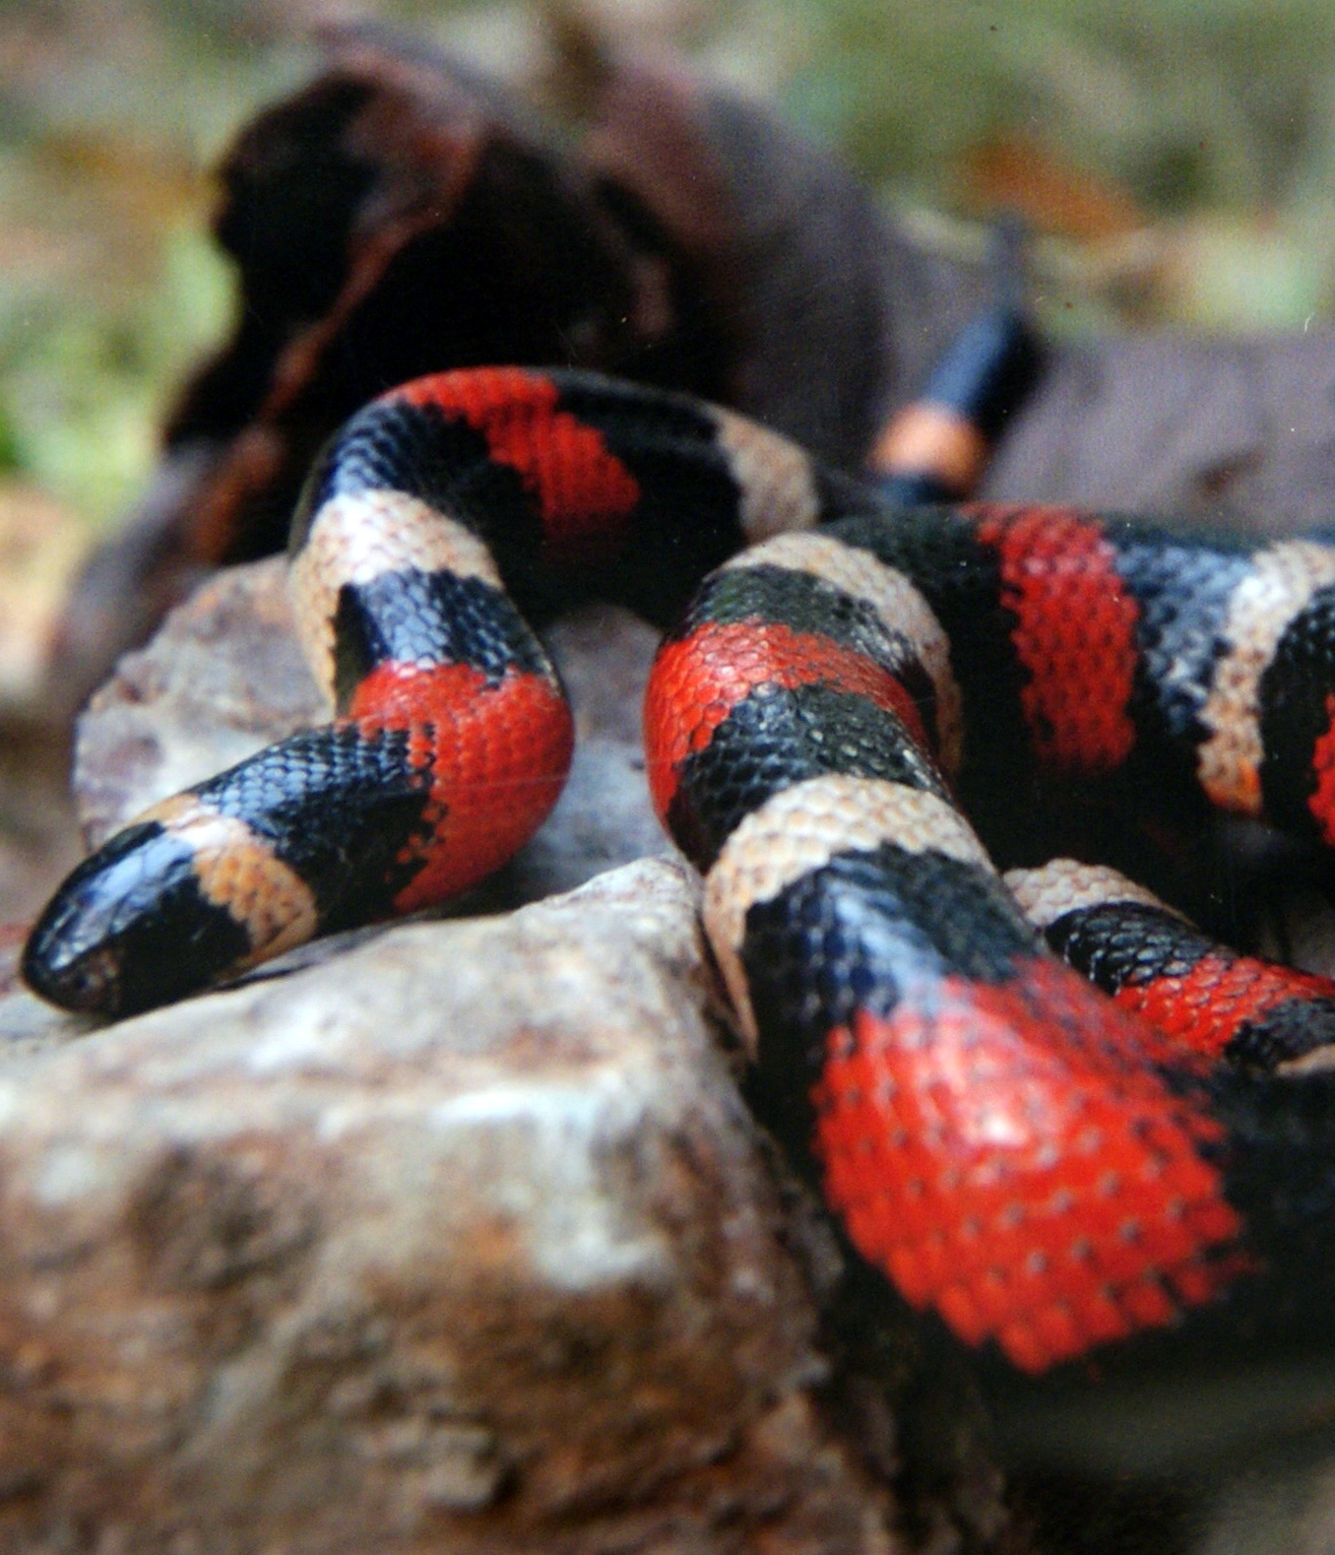
Genesis 3: Punishment
Serpent’s Punishment:
Will crawl, or slither, on the ground on its belly
Hatred between humans and snakes. This punishment foreshadows the fight between Jesus and Satan.
Eve’s Punishment:
Painful childbirth
Husband rules over her
Adam’s Punishment
Must work hard for food
Will die
Both Adam and Eve were also forced to leave the perfect paradise in the garden and live elsewhere in the changed world with sin.
Eve’s Punishment applies to women and Adam’s punishment applies to all of mankind.
Photo By:
Pxhere
Photo By:
GoodFreePhotos
Photo By:
Scary Mommy

Slide 19
Genesis 3: Questions and Answers
Did the animals in the Garden of Eden normally talk?
The serpent speaking to Adam and Eve is not the only instance in the Bible where an animal speaks. The prophet Balaam was rebuked by his donkey in Numbers 22:21-35.
We have to remember that while animals are not capable of speaking, there are powerful beings out there like God, angels, Satan, and demons who are capable of the impossible, including enabling animals to speak. In the Garden of Eden, it was Satan who was speaking through the snake, not the snake itself speaking on its own.
So, the Genesis 3 account is not suggesting that snakes were of an intellect that would have enabled them to speak coherently, but that they were used by Satan to speak.

Slide 20
Genesis 3: Questions and Answers
Still, why didn’t Adam and Eve find it strange that an animal was speaking to them?
It is unlikely that Adam and Eve had the same perspective we do on animals. We know from experience that animals are incapable of speech on the same level as humans. Adam and Eve did not have a childhood, nor did they have other humans to learn from. Given that Adam and Eve had probably only been alive a matter of days, it is not unreasonable for them to believe that animals were capable of speech.
It is also possible that this was not the first talking animal Adam and Eve had encountered. Satan or even God himself may have used animals to communicate with Adam and Eve before. There are so few details given in the account that much is left to speculation and presumption.
Lastly, it was not unreasonable for Eve to answer the snake. The snake was evidently speaking in a language that she understood and asking an intelligible question. It is also likely that Adam was nearby and could verify that she was not imagining things. It was not the serpent speaking that should have alarmed them, it was the fact that he was encouraging disobedience and doubt into their hearts (Genesis 3:1), contradicting GOD (Genesis 3:4), and calling GOD’s motives into question (Genesis 3:5). This should have encouraged them to stop communicating with this scheming serpent, much like us today.

Slide 21
GENESIS
Chapter 4

Slide 22
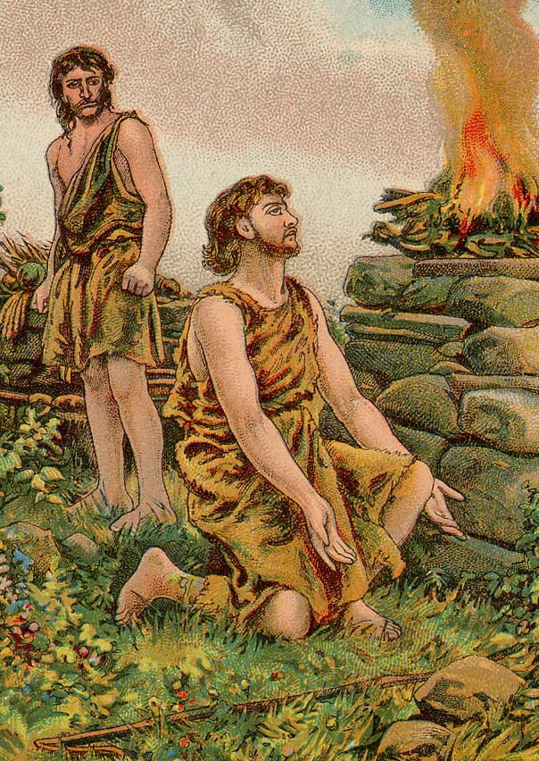
Genesis 4: Cain and Abel
The first sixteen verses of this chapter detail main events that occurred after Adam and Eve left the garden. Adam and Eve had two children, Cain and Abel. Cain was a tiller of the ground, like a farmer, and Abel was a shepherd.
Cain and Abel were both offering sacrifices to GOD and while Abel brought the firstlings of his flock, Cain brought the fruit of the ground. GOD respected Abel’s sacrifice and looked down on Cain’s.
Cain grew very upset, and GOD warned him that if he didn’t control his temper, sin could creep in.
While the two brothers talked in the field, Cain killed Abel and then denied the murder when questioned by GOD.
As punishment for his sin, Cain would have to labor very hard to till the ground and he was marked as a fugitive.
Photo By:
Wikipedia

Slide 23
Genesis 4: Cain and Abel
What is the meaning of the name Cain?
Cain = "possession"
1) eldest son of Adam and Eve and the first murderer having murdered his brother Abel
What is the meaning of the name Abel?
Abel = "breath"
1) second son of Adam and Eve, killed by his brother Cain

Slide 24
Genesis 4: Questions and Answers
Did Abel say something to cause the war with his brother (Genesis 4:8)?
Cain and Abel had been talking in the field and Cain seemed to have suddenly rose up against his brother. Could this have been because of something that Abel said? This is a question that we do not know the answer to because we were not there. However, even if Abel had said something to provoke him, Cain was not justified in killing his brother.
Why does God ask questions He knows the answers to?
In this instance, Cain was asked where his brother Abel was as an opportunity to tell GOD the truth of what he did and repent.
Does Blood have a voice?
The Bible states in 1 John 5:8 that the blood, is one of three entities that bear witness in earth, "And there are three that bear witness in earth, the Spirit, and the water, and the blood: and these three agree in one." (King James Version Bible)
Going back to Genesis 4:10 which tells of Abel's blood crying out to God, it appears that Abel’s blood was giving testimony, bearing witness, to his murder. Much the same way blood evidence at a crime scene gives a testimony to the detectives about the events that took place when the crime occurred.
According to 1 John 5:8 in the King James Version and Genesis 4:10 blood has a voice that God hears. This crimson voice bears witness, gives testimony from earth. When a life is taken, just as was Abel’s, the blood of the slain testifies to God.

Slide 25
Genesis 4: Questions and Answers
What curse proceeded from this event? Was the mark the mark of the beast? vs 9-15/Revelation 13
Cain's curse and mark have been interpreted in several ways. Following the literal Biblical text, most scholars interpret the "curse" as Cain's inability to cultivate crops and his necessity to lead a nomadic lifestyle. They interpret the "mark" as a warning to others but are unable to determine the form of the mark from the Biblical text.
Historically, some Christians have interpreted the Biblical passages so that the "mark" is thought to be part of the "curse". In 18th century America and Europe, it was commonly assumed that Cain's "mark" was black skin and that Cain's descendants were black and still under Cain's curse. While the majority of Cain's descendants were killed in the great flood, Latter Day Saints from the late 19th to mid 20th century believed that Cain's bloodline was preserved on the ark through Egyptus. Egyptus was a Cainite married to Noah's son Ham. While this was an almost universally held view amongst the LDS it was not canonized doctrine.
Accepting the theory that God had cursed black people, some have used the curse as a Biblical justification for racism. These racial and ethnic interpretations of the curse and the mark have been largely abandoned even by the most conservative theologians since the mid-20th century, although the theory still has some following among white supremacists and an older generation of whites, as well as a very small minority of Protestant churches.

Slide 26
GENESIS
Chapter 5

Slide 27
Genesis 5: Genealogies
If you look at the meanings of the names and you can understand how they are significant to the events that occurred.
Seth: "compensation“
Enos = "man“
Cainan (Kenan) = "possession” (Like Cain)
Mahalaleel = "praise of God“
Jered or Jared = "descent“
Enoch = "dedicated"
1) eldest son of Cain
2) son of Jared and father of Methuselah
3) God took him home to heaven without dying
Methuselah = "man of the dart“
Lamech = "powerful“
Noah = "rest“
Shem = "name“
Ham = "hot“
Japheth = "opened"

Slide 28
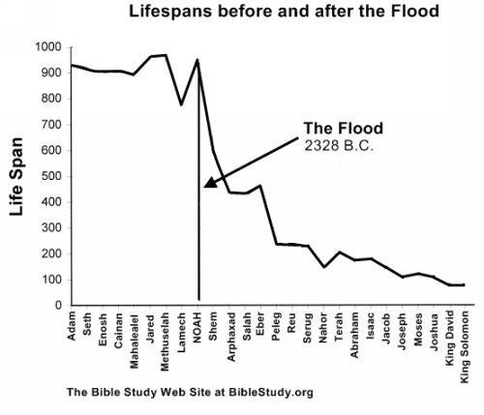
Genesis 5: Questions and Answers
Why did human beings live so long before the flood as opposed to now?
Photo By:
Pinterest

Slide 29
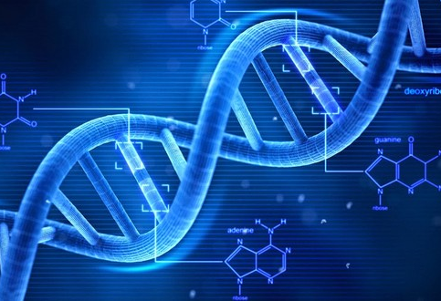
Genesis 5: Questions and Answers Why did human beings live so long before the flood as opposed to now?
Photo By:
Pixabay
One of the most intriguing facts in the Bible is the immense life spans of the patriarchs before and just after the flood. Adam lived 930 years, Methuselah the longest lived of the patriarchs lived 969 years. Noah lived 950 years. Many scoffers state that these extended life spans are nothing more than myths and legends. They state that the figures given for the various ages of the patriarchs are fabricated.
There are many factors that could account for the lowering of the life spans after the flood. The Bible states that the flood would not only destroy the land dwelling air breathing animals but it would also destroy the earth (Genesis 6:13; 9:11).
After the flood, the earth was completely different than the earth before. There were widespread global differences. These would include changes in the climate, composition of the atmosphere, hydrologic cycle, geologic features, cosmic radiation reaching the earth, ozone concentration, ultra violet light, background radiation, genetics, diet, and a host of other subtle and/or profound chemical and physiological changes. These changes caused a rapid decline of the longevity of post flood humanity.
Photo By: FactRepublic

Slide 30
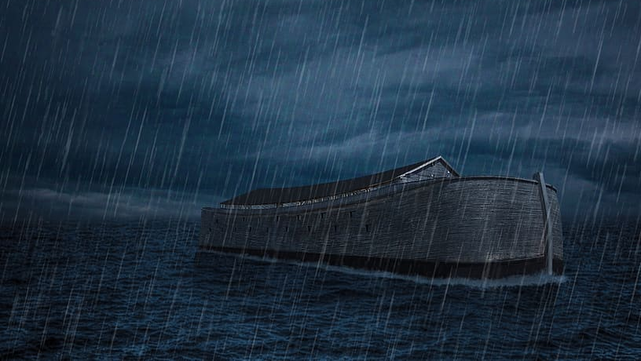
Genesis 5: Questions and Answers Why did human beings live so long before the flood as opposed to now?
Shortly after the Flood, however, we find people living much shorter life spans. Abraham, for example, lived 175 years (Genesis 25:7). A few generations later, Joseph lived "only" 110 years (Genesis 50:22). We are told in the Psalms that 70 years is considered to be a long life, and men reach 80 years only "by reason of strength" (Psalm 90:10). David died at age 70 in about 1000 BC and is described as dying "in a good old age, full of days" (I Chronicles 29:28).
There have been many speculations concerning the great length of human life spans before the Flood, such as the earth having a thick water vapor canopy that blocked out most of the sun's harmful radiation, or double atmospheric pressure that enhanced the health of all organic life. The Bible, however, does not directly explain why this was or why life spans shortened after the Flood.
Possibly, God simply determined that the longer pre-Flood life spans only multiplied the evil men can do (see Genesis 6:3-7, 11-13) and that about 70-120 years is long enough for a person to fulfill his purpose. Those who are called can prepare in that length of time to receive immortality at the return of Christ. Those not yet called can learn that the ways of man do not bring satisfaction or fulfillment. Thus, when they arise in the second resurrection, they will be prepared to choose God's way.
Photo By:
Wallpaper Flare

Slide 31
Genesis 5: Questions to Consider
Was this the same Nod from Eden? (verse 16)
Where did Enoch go? 5:24 What did he do that was so pleasing?
Hebrews 11: 5-6
Photo By:
Blogspot

Slide 32
GENESIS
Chapter 6

Slide 33
Genesis 6: The Global Flood
This chapter describes the wickedness that GOD saw on Earth as time had passed. Even the Earth itself had been corrupted through the violence of mankind.
As punishment for this wickedness, GOD decided to send a global flood to Earth, destroying the earth and wiping out all of mankind.
There was one man, Noah, that GOD saw as righteous and just.
GOD appointed Noah to build an ark to save his family and a collection of animals. The dimensions of the ark were very specific as it had to withstand a global flood.
Noah was commanded to gather food to provide for his family and the animals while they were in the ark.
Those in the ark would replenish the Earth.
Noah obeyed all of GOD’s instructions.
Photo By: Testify God

Slide 34
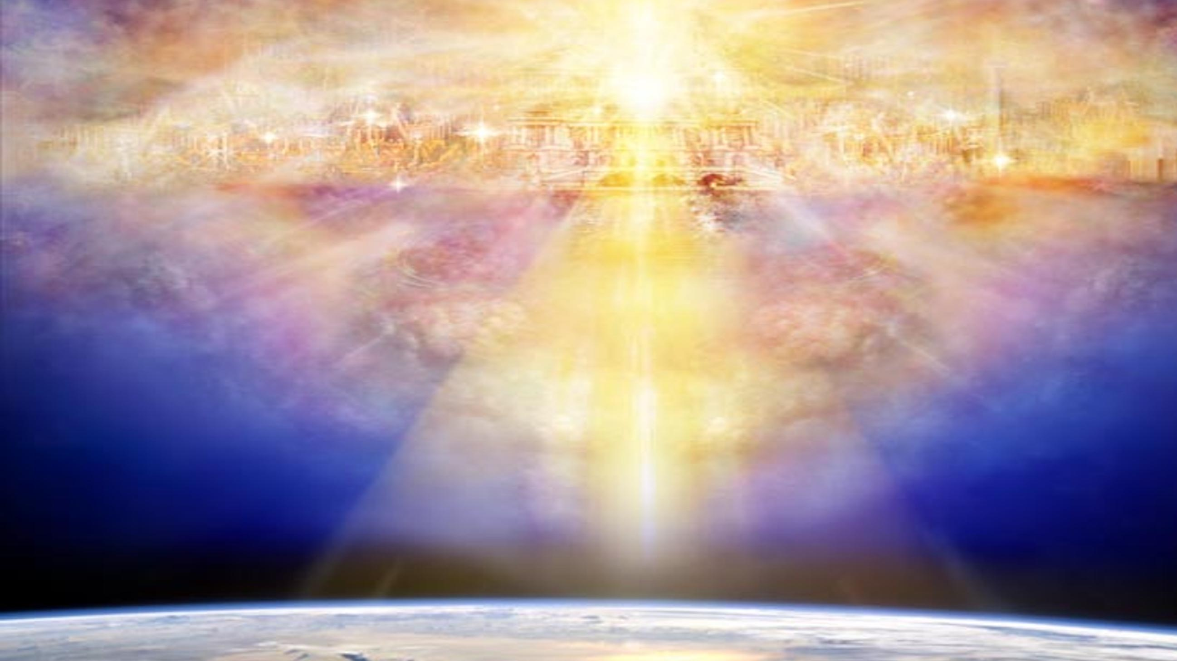
Genesis 6: The Global Flood
The experience of Noah is prophetic of the new heaven and new Earth (Revelation 21:1-2), as it demonstrates the destruction and rebuilding of Earth along with its inhabitants.
The experience of Noah also emphasizes the scripture Matthew 9:16-17, because the Earth was again destroyed and tainted with sin even after the global flood.
Furthermore, this scripture teaches the importance of preparation, as well as how to properly prepare, clear in Noah’s example following GOD’s instructions.
Photo By: Third Church NYC

Slide 35
Chapter 6: Questions and Answers
Verses 6-7 – Can GOD repent? What does it mean for GOD to repent? Compare the scriptures:
God does not repent. | God repents.
1 Samuel 15:29 | Genesis 6:6
Ezekiel 24:14 | Exodus 32:14
Malachi 3:6 | Deuteronomy 32:36
James 1:17 | 1 Samuel 15:11, 35, 2 Samuel 24:16
 | 1 Chronicles 21:15
 | Isaiah 38:1-5
 | Jeremiah 18:8; 26:3, 13, 19; 15:6; 42:10
 | Amos 7:3, 6
 | Jonah 3:10
People repent for forgiveness of sins, but GOD does not sin. So, what does it mean for GOD to repent? The Hebrew word for repent translates to regret or feel remorse. So, in this case in Genesis 6:6, GOD was disappointed by the sinful actions of the people – HE was grieved to see the sin of the people.

Slide 36
Genesis 6: Questions and Answers Who are sons of GOD/daughters of men?
Gen. 6:2-4: “That the sons of God saw the daughters of men that they were fair; and they took wives for themselves of all whom they chose.…There were giants in the earth in those days; and also afterward, when the sons of God came in unto the daughters of men, and they bare children to them, the same became mighty men which were of old, men of renown.”
The question of the mention of sons of God in Gen. 6 has always provoked much controversy. Did Angels co-habitat with humans or were they the godly descendants of Seth that took women from the ungodly line of Cain.
It has been the opinion of the majority of Rabbis that this event had actually occurred, and that they were indeed angels. Ancient rabbinical sources, and the Septuagint translators in the 3rd century before Christ all upheld this view. The early church agreed with this view almost to the end of the fourth century. ( Justin, Cyprian, Athenagoras, Eusebius, also Josephus, Philo, and Judeaus accepted this traditional view.

Slide 37
Genesis 6: Questions and Answers Who are sons of GOD/daughters of men?
Today there are many conservative scholars that hold to the view of the sons of men being actual angels. While we don't interpret the Bible because of their view, it is good to read why they have come to these conclusions.
The Hebrew word for sons of God is Bene elohim. This term for angels occurs four times in the Old Testament in the Septuagint version (the Greek translation of the Hebrew scriptures ) it's meaning is always used as angels of God, never of man. Most scholars believe this event describes a union between fallen angels who cohabitated with human females. This unnatural occurrence of combining two different species resulted in a offspring of what is called 'giants' in the King James and NKJ version and Nephilim in the New American Standard, and the English translation of the Jewish Masoretic text.

Slide 38
Genesis 6: Questions and Answers Who are sons of GOD/daughters of men?
The main scriptural argument for the Sons of God not being angels is the scripture Matthew 22:30 Jesus describes the Holy angels in heaven as not marrying, nor reproducing after their own kind.
This argument proposes that the Sons of God must be human because a sexual union between angels and humans is impossible and leans towards Greek mythology. Since angels are sexless this terminology could easily be referring to godly men (Hosea 1:10 you are sons of the living God). It is an assumption that sons of GOD refers to the “sons of Seth.”
The main objection then is that angels do not reproduce sexually, however if we look at the verse more carefully, we see Jesus stating that the angels of God in heaven neither marry nor are given in marriage. He gives a specific location, which gives us only two alternatives. Because of where they are located it is a functional impossibility, or that he is referring to only the angels that obey God do not marry. Either way it leaves open the possibility of this occurring on Earth and with the fallen angels that are disobedient to God.
What are angels exactly?

Slide 39
Genesis 6: Questions and Answers
ANGELS (ARE):
Created beings (Neh 9:6)
Not eternal and omniscient
Endowed with free will
Not impervious to temptation and sin (Revelations 12:7-9)
Hebrew word for angel is ‘Mal’ak’ and greek word is ‘angelos’, both meaning ‘Messenger’. So in this context, Angel is described as a Messenger of God.
In Popular culture, Angels are always portrayed as winged creature. But in bible, only ‘Cherubim’ and ‘Seraphim’ are identified as winged creatures. (Isa 6:2-4, Ezk 1:5-6)
Within biblical texts, angels are almost always appeared as men!
Hebrew 1:14 represents Angels as ‘Ministering spirits’ sent to serve those who will inherit salvation.
Jesus Christ received angelic ministry several times. (Mt 4:11, Luke 22:43)
Associated with final judgment (Mt 16:27)
They are also named ‘Sons of God’, ‘Holy ones’, ‘Heavenly hosts’. (Gen 6:2-4, Ps 89:5, Dan 4:13, Luke 2:13)
Worship God (Luke 2:13, Rev 19:1-3), attends God’s throne (Job 1:6, 2:1)
God’s army (1 Chron 12:22)

Slide 40
Genesis 6: Questions and Answers
DEMONS/FALLEN ANGELS (ARE):
regarded as Evil spirits, Unclean spirits, deceitful spirits.
Fallen angels who joined Satan in his rebellion (Revelations 12:7-9)
Follow Satan
In Old testament, no individuals are said to be possessed!
People sacrificed children and unclean animals to appease the demon/demons. (Ps 106:37, Deut 32:17). Such demonic practices are strictly prohibited in Bible. (Deut 18:10-12)
In New testament, there are several incidents of possession of an individual by evil, demonic spirit.
Demon possession caused
Muteness (Matthew 9:32, 12:22, Mark 9:17,25)
Deafness (Mark 9:25)
Blindness (Matthew 12:22, John 10:21)
Convulsions (Mark 1:26, 9:26)
Superhuman strength (Mark 5:4)
Self destruction behavior (Matthew 17:15, Mark 5:5)
Unnatural voice (Mark 5:7)

Slide 41
Genesis 6: Questions and Answers
DEMONS/FALLEN ANGELS:
New testament is very clear about the distinction between physical diseases and demonic possessions. (Mat 4:24, Acts 19:12).
There are many incidents of Jesus casting out demons.
Jesus generally, did not let demon speak.
Jesus himself was accused of possessed by demon!
Demons are not atheists!
Know God
know Jesus and his divinity even before the disciples could realize. (Mark 5:13, Luke 4:34)
They know their fate. (Mark 5:7, Luke 4:34)
Mat 5:7: (Ask Jesus)
They may have names. (Mark 5:9)
They know who God’s servants are. (Acts 16:16-18)
They know the Gospel. (Acts 16:18)

Slide 42
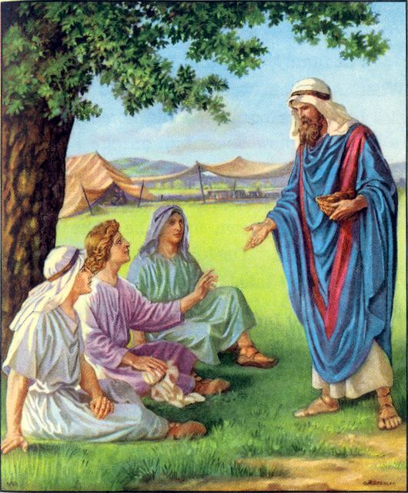
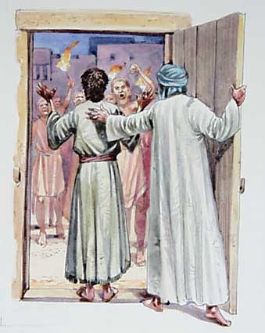
Exploring Angelic Beings: Researching the Theories
Photo By: La Vista Church of Christ
1. What Mt.22:30 does specifically say is that angels do not marry. Marriage was given to generate new offspring. Angels do not have the ability to procreate among their own species. They may or may not be sexless; although they are in an invisible spirit form, they are pictured as male, with male names Michael, Gabriel. They are also called sons of god not daughters. When they become visible, they usually appear as young men (Luke 1:11-12, Revelation 12:7). God made an innumerable amount of angels simultaneously, he does not continue creating them, so they never increase or decrease in number.
2. We find in the scriptures that angels can appear as men even though they are spirit creatures. They can perform numerous human functions such as eating food as in their encounter with Abraham in Genesis 18. They can perform other bodily functions as well; they can walk and talk among us in such a way that we may not be aware of them unless they reveal themselves (Heb. 13:2).
3. The angels that came to warn Lot were mistaken for men and were sought out for homosexual use by the men of Sodom.
Photo By:
EliSoriano

Slide 43
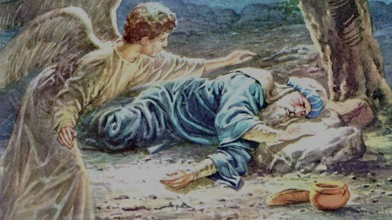
Exploring Angelic Beings: Researching the theories
4. Angels are also able to carry out God's plans on Earth by supplying food for man (1 Kings 19:5-7, Mt. 4:11). They are able to execute God's judgment (Revelation 7:1, 14:17) and inflict punishment upon man (Ezekiel 9:1-8, Acts 12:23). There seems to be some change of substance that takes place on Earth that they can become physical, contrary to their original nature. So, if they can possess a body of a man and can eat and carry out other functions then why not other abilities? Who else do we know was transformed into man to carry out a certain task?
5. The term Son of God is never used of man in the Old Testament, only of angels. (Job.1:6,2:1, 38:7). The only exception is Nebuchadnezzar who said of the one who was in the fire with Shadrach, Meshach, and Abed-Nego, was like the Son of God (Dan. 3:25). He was probably stating this from his Pagan perspective.
Photo By: Safe-Children-Site

Slide 44
Genesis 6: Questions and Answers
When the righteous marry the unrighteous they do not give birth to such unusual offspring, unless there is another element to this event. How else can one explain the offspring of this union which are described as “mighty men who were of old, men of renown” in Gen. 6:4?
This is a description of their power and fame (their abilities intelligence, and strength far exceeded other men.) If we look at the affect on humanity from this forbidden act it indicates that man became incredibly evil, where his thoughts were bent on evil all day long and he filled the earth with violence. (Gen. 6:5,13) with this afterwards as the affect from the unnatural offspring of humanity God decides to destroy the Earth.
This was such a violation to GOD’s created order that it altered mankind and necessitated a worldwide flood.

Slide 45
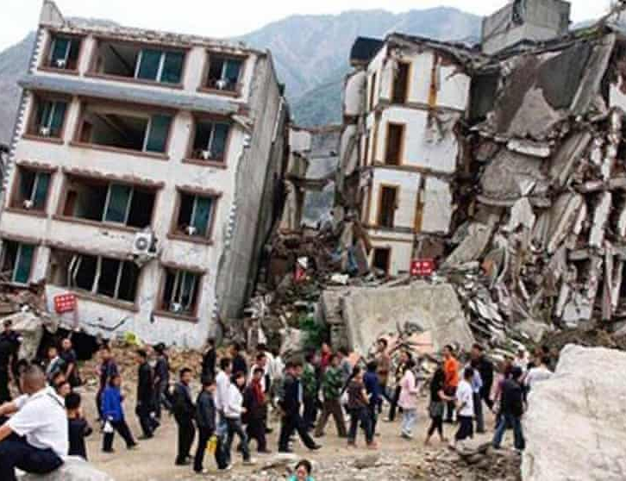
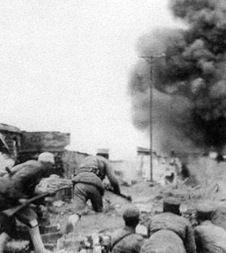
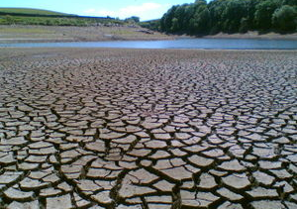
Genesis 6: Questions and Answers
Photo By: The Guardian
Photo By:
Wikipedia
God does not change… so where is the drastic judgment of God for these acts today?
GOD already stated that there would never be a worldwide flood again. In today’s day, we can see punishment in different forms:
Epidemics, pandemics, etc.
Natural Disasters
Birth Defects
Wars
Famine, drought, etc.
Photo By:
Energy Education

Slide 46
GENESIS
Chapter 7

Slide 47
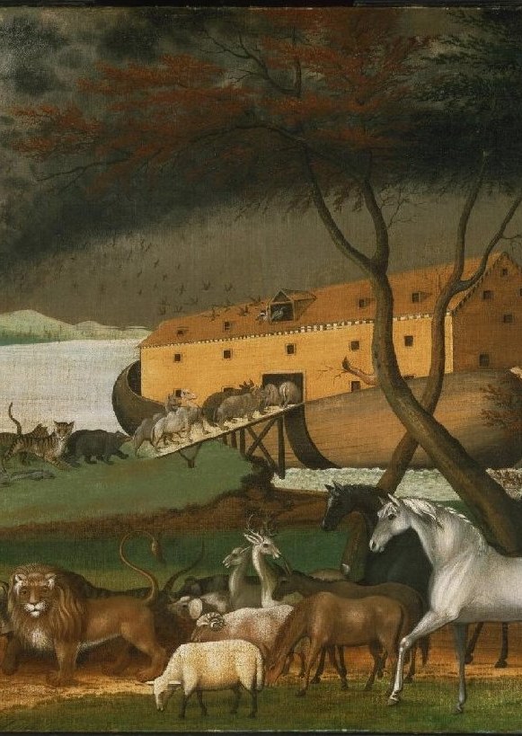
Genesis 7: The Global Flood
In these verses, we can see that GOD instructs Noah as to how the animals must be gathered in the ark.
Of each kind of clean animal, there were to be seven males and seven females. Of the unclean animals, there were to be two males and two females. Of all fowls, there were to be seven males and seven females. (Leviticus 11:1-31)
The scripture describes how Noah, his family, and all the animals entered the ark, and GOD shut them in.
As the rain raged on for forty days and forty nights, the sea level rose 15 cubits (about 23 ft.), covering the mountains.
All living things on the dry land outside of the ark died.
Photo By:
Wikipedia

Slide 48
Genesis 7: Baptism
THE ARK & BAPTISM
In 1 Peter 3:20-21, the apostle Peter makes the comparison of Noah's salvation in the ark, and our salvation by baptism: "...God waited in the days of Noah, while the ark was a preparing, wherein few, that is, eight souls were saved by water. The like figure whereunto even baptism doth also now SAVE us.“
For people to say they are saved before baptism is to say that Noah and his family were saved before the flood! Noah's obedience and work did not earn him salvation, but if he had not worked to build the ark, he would have been lost! In the same way, baptism does not earn us salvation, but we must be baptized to be saved. Peter says "baptism doth also now save us."
Photo By:
Groundwork

Slide 49
Genesis 7: Questions and Answers
After the Flood, GOD gave man permission to eat living things. Would this be an example of GOD changing HIS preset laws?
In Genesis 9:3, the words “shall be”, in the original Hebrew, mean “to be, to become, to exist”.
Thus, GOD did not command us to eat meat, he allowed us to. Mankind in their fallen state wanted to eat meat, so GOD set rules for eating it (Leviticus 11, Genesis 9:4, Acts 15:29). This does not mean that he wanted us to eat meat.
There are many examples of GOD “conceding” to man in the Bible:
Numbers 11:4-6, 10, 18, 31-33: GOD “gave in” to the Israelites in the wilderness when they whined for flesh to eat instead of the manna. Although it wasn’t GOD’s desire for them to eat the quail, he “allowed it”.
Matthew 19:8: GOD explained that it was because of the hardness of the people’s hearts that Moses gave permission for divorce. Of course, GOD is against divorce (Mark 10:9).

Slide 50
Genesis 7: Questions and Answers
The killing of innocent flesh, whether human or animal, for any reason, was not God’s original intent for man or animals. There was no violence of any kind before the Fall, neither will any of God’s creatures hurt nor destroy each other in the world to come.
Psalm, 145:10,21, Psalm 148:10-13, Psalm 150:6, Isaiah 42:10, Revelation 5:13
Numbers 16:22, Numbers 27:16, Ecclesiastes 3:18-21,
Isaiah 40:5, Isaiah 52:10, Psalm 36:6, Psalm 104:24-30, Nehemiah 9:6, Mark 16:15,
Luke 3:6, Acts 3:20,21, Romans 8:19-21, 1 Corinthians 15:22,38-44, Colossians 1:19,20,23, Hebrews 1:1

