Slide 1
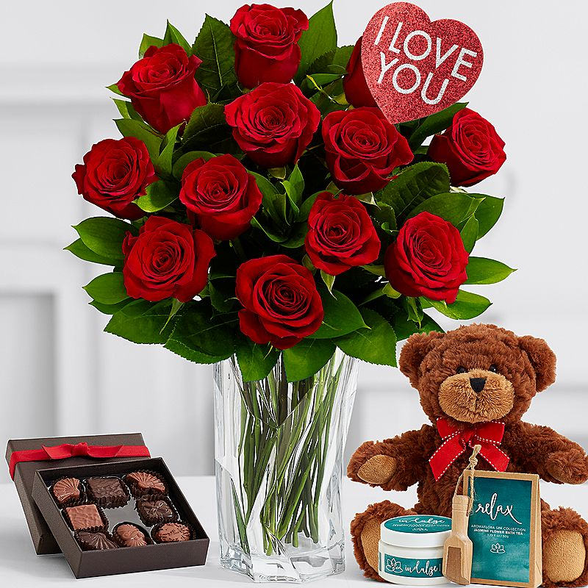
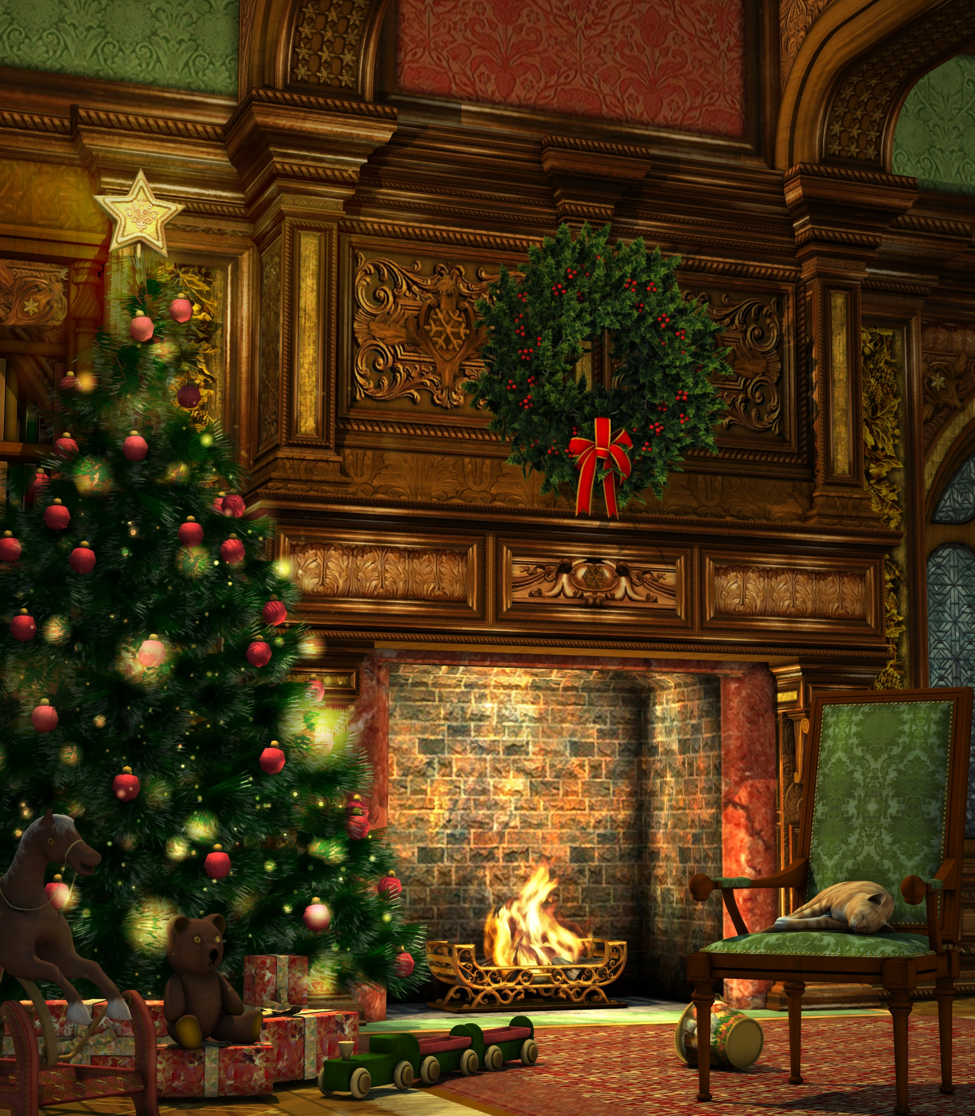
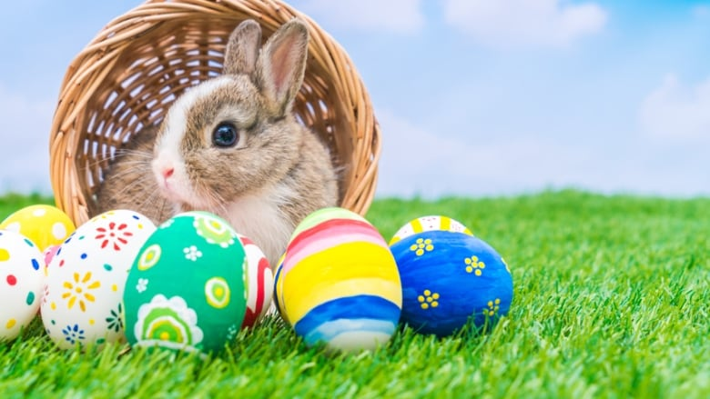
The Pagan Holidays
Photo By: Alina K. Field
Photo By: shuttershock
Photo By: PraiseWorld Radio
Photo By: CBC
And Why We Don’t Celebrate Them

Slide 2
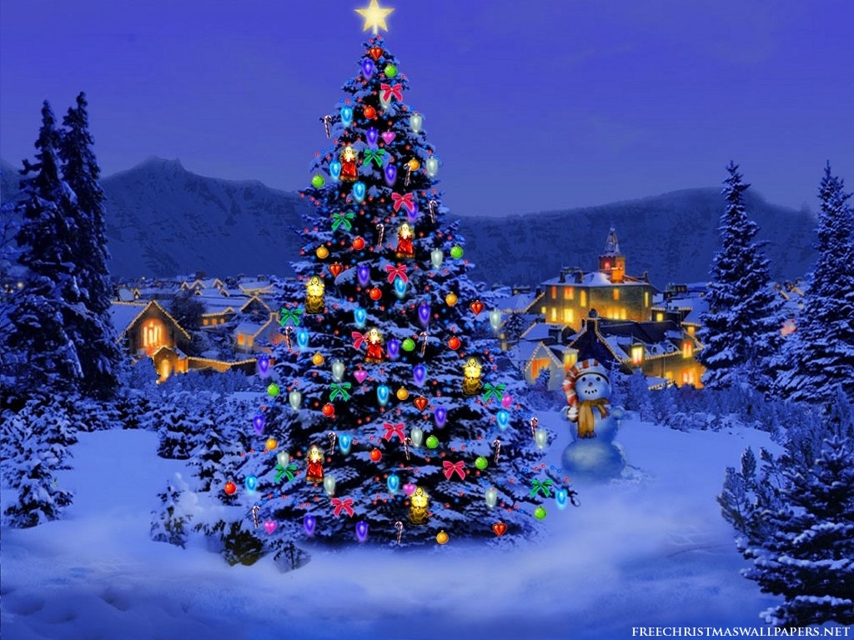
Christmas
X-MAS
Photo By: Blogspot

Slide 3
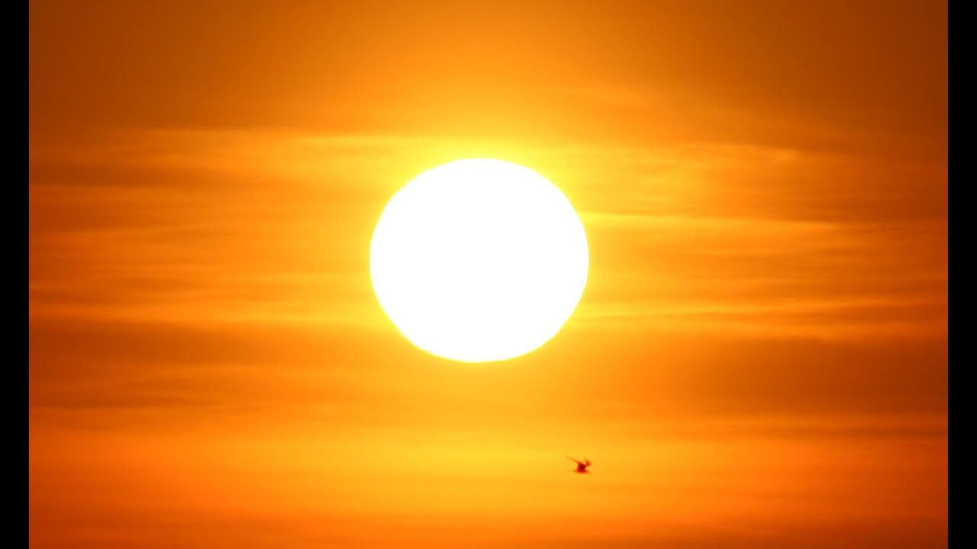
The Origins Of Christmas; the winter solstice
Astronomically, the winter solstice is around December 21st or December 22nd, but the naked eye can’t distinguish the return of the sun until December 25th.
So, the 25th of December was considered the birthday of the sun to the ancients.
Because the sun seemed to stop in the sky, sun worshippers wanted to make the sun continue its movement.
And God spake all these words, saying, I am the LORD thy God, which have brought thee out of the land of Egypt, out of the house of bondage. Thou shalt have no other gods before me.
- Exodus 20:1-3
This scripture shows us that we are not worship any false gods, we must only worship GOD. Therefore, in celebrating Christmas and celebrating its origins, you are worshiping a false god, the ‘god of the sun’ and disobeying GOD.
Photo By: AlfieAesthetics

Slide 4
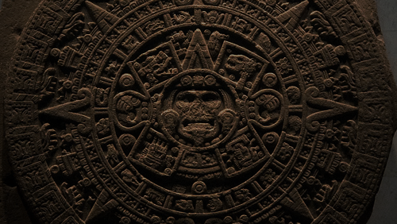
The origins of Christmas; Human Sacrifice
Photo By: The Grandma’s Logbook
Human sacrifice began to be practiced with the belief that it ‘re-energized’ the sun with the life of the sacrificed.
Thou shalt not do so unto the LORD thy God: for every abomination to the LORD, which he hateth, have they done unto their gods; for even their sons and their daughters they have burnt in the fire to their gods.
- Deuteronomy 12:31
As we can see from this verse, GOD commands us that we are not to sacrifice our children to false gods. So, again we can see another instance of blatant disobedience to GOD’s laws in celebrating Christmas.
One of the ancient European names of Christmas was Midvinterblot, meaning “midwinter blood” or “midwinter sacrifice”.
The ancient people practiced rituals with self-mutilation, torture, and mass human sacrifice because they believed that the heavenly bodies required human assistance.
Ye shall not make any cuttings in your flesh for the dead, nor print any marks upon you: I am the LORD.
- Leviticus 19:28
This scripture shows us that we are not to cuts and mark our bodies. However, this is precisely what the ancients did in rituals. It is important to remember that celebrating Christmas is also celebrating its pagan roots that defy GOD’s words.
In one day, over 10,000 Aztec children were sacrificed at the Temple of the Sun.

Slide 5
ORIGINS OF CHRISTMAS
Photo By:
The J. Paul Getty Museum
In Ancient Egypt, Egyptians worshipped the false sun god, Ra. Like the beliefs of the Mayans, Egyptians believed that during winter, Ra became ill, but began to heal at the winter solstice. They celebrated his healing by decorating their homes with green palm rushed, symbolic of triumph over death.
In Rome, Romans celebrated Saturnalia in honor of Saturn, the false god of agriculture. To celebrate the upcoming harvest and springtime, the Romans decked homes and temples with evergreen boughs.
Druids, the priests of the ancient Celts in Northern Europe, decked their temples with evergreen boughs to symbolize everlasting life.
Vikings in Scandinavia worshipped the false sun god Balder and set the evergreen tree as his special plant.
Photo By: Luz y Oscuridad

Slide 6
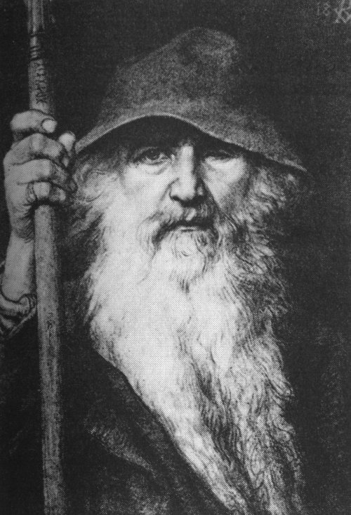
SYMBOLS OF CHRISTMAS
Santa Claus
The legend can be traced back to a monk named Saint Nicholas, born in Turkey around 280 A.D.
Saint Nick entered American culture in the late 18th century through Dutch families who gathered to commemorated the death of Saint Nicholas, also known as Sinterklaas (short for Sint Nikolaas, Dutch for Saint Nicholas).
Another element of Santa Claus, came from people in Germany who worshipped the pagan god Oden. These Germans believed that Oden made flew through the sky at night to decide who would live or die (reflected today in “naughty or nice”, those who get gifts and those who do not).
This encouraged people to stay inside, which is reflected today in the fact that Christmas can be recognized as one of the few holidays that is spent mostly indoors.
Leaving cookies and milk for “Santa” is essentially a meal offering to these false gods, which GOD prohibits (Exodus 20:3-6.
Photo By: Wikipedia
Photo By: Catholic Online

Slide 7
SYMBOLS OF CHRISTMAS
The Christmas tree
The Christmas tree was brought to America by German immigrants in the 1800s. In ancient times, people believed that evergreen trees could disable ghosts, illness, evil spirits, and witches, and revered them in high regards. Throughout various cultures, evergreens were revered as representative of false gods, powerful healers, etc.
As with many other pagan practices of Christmas, this is worship of false gods (Exodus 20:3-6).
Furthermore, the Bible blatantly speaks against decorating trees and putting them in the house (Jeremiah 10:2-5)
“12th Day of Christmas” Song
In Medieval Europe, Christmas was celebrated over a span of twelve days full of feasting and drinking excessively.
Scripture speaks against drinking on multiple occasions (Hosea 4:11)
Mistletoe
Mistletoe was considered by the pagan Celtic people and Teutonic people to have magical powers to heal and bring fertility (hence kissing under the mistletoe). Mistletoe was hung in the homes of Celts to bring good luck and remove evil spirits.
Photo By: Pexels

Slide 8
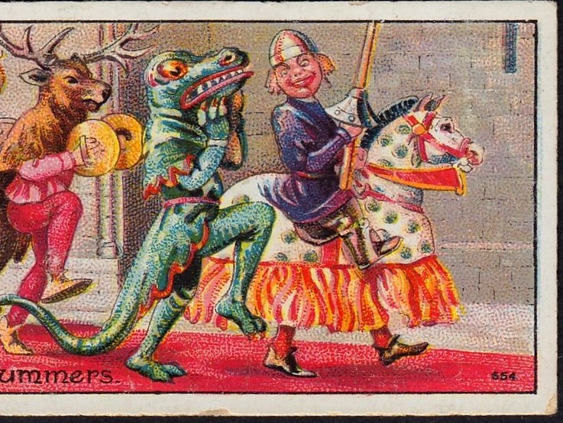
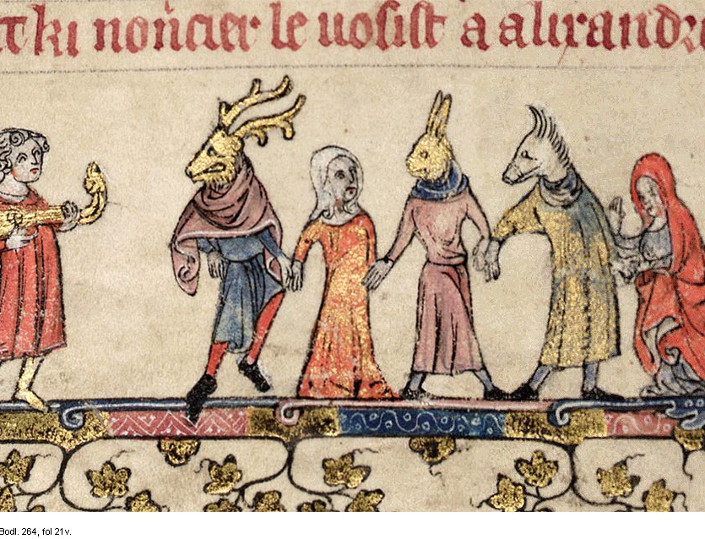
Symbols of Christmas
Photo By: Flickr
Christmas Eve
In the Middle Ages, the holiday began before dawn on Christmas morning with a special mass.
Christmas Carols
This originated from an activity known as mumming, which was practiced in medieval English villages.
Those who participated in this activity, known as mummers, dressed in animal masks or dressed up as women, and went door-to-door singing folk songs or telling jokes.
This wicked tradition clearly goes against scripture (Deuteronomy 22:5, Romans 1:26-27).
Christmas Gifts
Originated in medieval times in which the rich would give to the poor to avoid violence. If the rich did not provide the poor with a gift or money, the poor destroyed their homes or committed acts of violence against them.
Traditionally, children are given dolls for winter solstice and these dolls, or idols, are placed under the Christmas tree. This is thought to be representative of the sacrifice of children under a grove of evergreen trees.
Photo By: Family Christmas Online

Slide 9
Halloween
Photo By: Discover Torrance

Slide 10
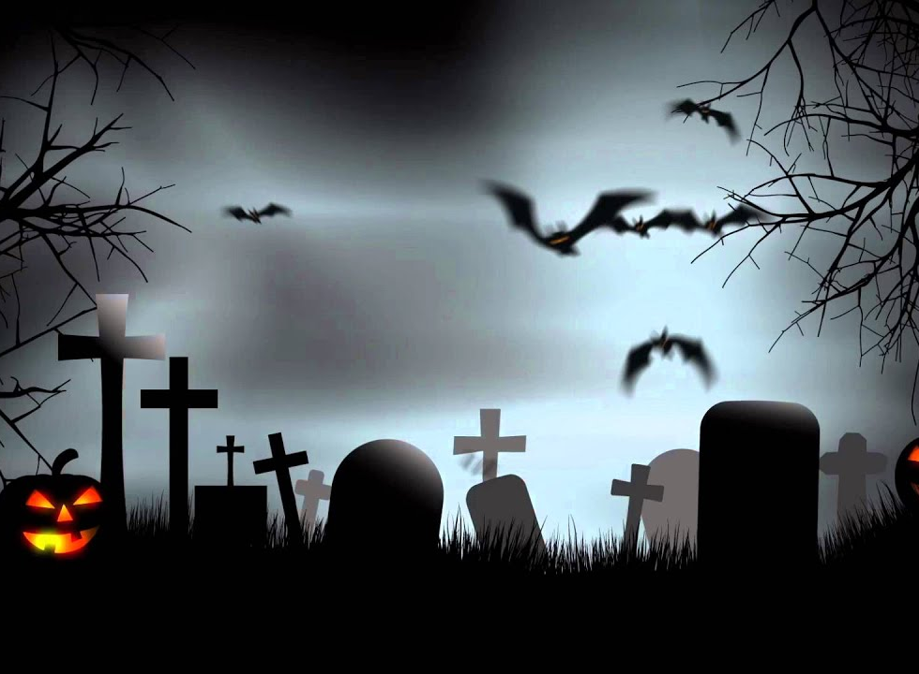
Halloween
Halloween began over 2,000 years ago by the Celts and their pagan priests, the Druids.
Druids are considered the worst of the occult and were consulted for instruction on witchcraft, satanism, paganism, etc.
And he caused his children to pass through the fire in the valley of the son of Hinnom: also he observed times, and used enchantments, and used witchcraft, and dealt with a familiar spirit, and with wizards: he wrought much evil in the sight of the LORD, to provoke him anger.
- 2 Chronicles 33:6
This scripture shows us that the creators of Halloween, the Druids were wicked in GOD’s eyes as they operated with witchcraft, satanism, paganism, etc. In celebrating Halloween, you celebrate their pagan rituals.
Photo By: virtual-studio-set.com

Slide 11
Halloween
The Druids created Halloween.
The Druids celebrated two special nights of the year: Beltane (May 1, the birth of summer) and Samhain (November 1, the death of summer).
Samhain, the most important ritual, was a terrifying night full of human sacrifices that was dedicated to celebrating death and hell.
This was the original Halloween.
The Druids believed that during Samhain, the veil separating the dead from the living opened and evil spirits roamed searching for someone to possess.
Photo By: Blogspot

Slide 12
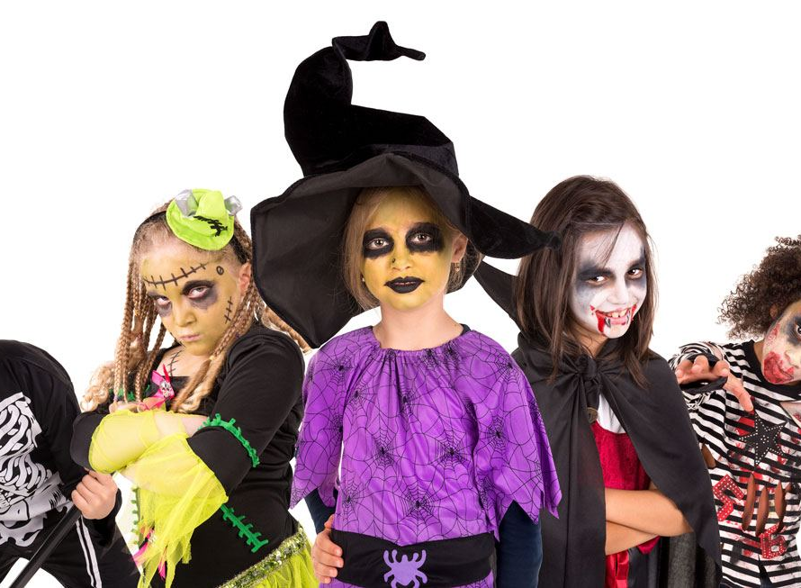
Halloween
So, the Druids taught the Celts to dress up as demons, evil spirits, and ghosts, hoping to convince the roaming spirits that they were another evil spirit so that they would be left alone.
The tradition of trick-or-treat originated from the Celts preparing gifts (treats) to appease the evil spirits from committing crimes or malicious acts (tricks).
Additionally, during Samhain human sacrifices and rituals were performed, creating a covenant with death and hell.
Because ye have said, We have made a covenant with death, and with hell are we at agreement; when the overflowing scourge shall pass through, it shall not come unto us: for we have made lies our refuge, and under falsehood have we hid ourselves:
- Isaiah 28:15
That verse tells us that those who make a covenant with death and hell live in lies and wickedness, something that GOD doesn’t want anyone to do.
Photo By: Hogs Breath

Slide 13
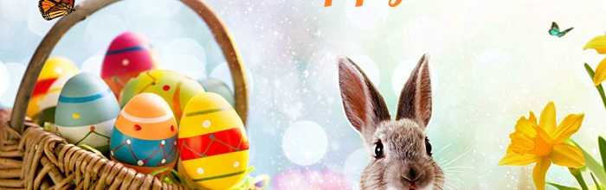
EASTER
Photo By: Prepaid Phone News

Slide 14
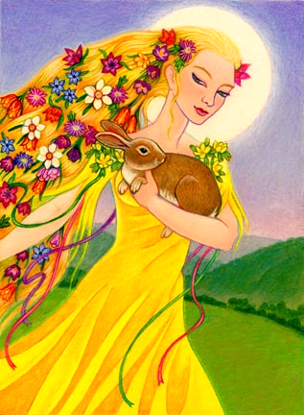
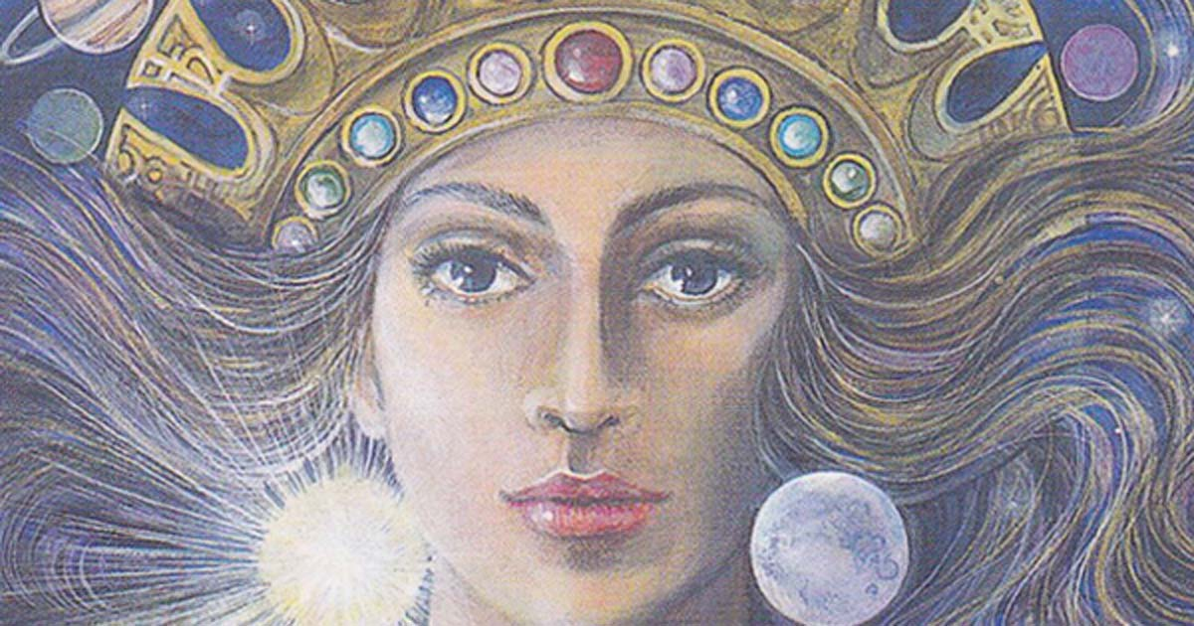
Easter
Photo By: Tumblr
Photo By: Ancient Origins
I am the LORD, and there is none else, there is no God beside me: I girded thee, though thou hast not known me:
- Isaiah 45:5
From this verse, we can see that GOD doesn’t want us worshipping false gods, which is what you do when celebrating Easter.
Easter comes from the celebration of two different pagan goddesses; Ishtar and Eostre.
Eostre
Ishtar
The Anglo-Saxon goddess of spring and fertility, Eostre or Eostrae.
There are many names for this pagan goddess, as languages differ.
Pagans celebrated Eostre in a month called Eosturmonath in Old English, which we now call April, an eighth century monk wrote.
In German mythology, Eostre healed a wounded bird by changing it into a hare, and because the hare was partially a bird, it thanked her by laying eggs as gifts.
Easter eggs represent fertility and birth, a reference to the pagan goddess, Eostre.
The Easter bunny is also a representation of the symbol for Eostre, a bunny.
Additionally, bunnies are seen a representation of fertility as rabbits are known as extremely reproductive creatures, reproducing many baby bunnies in springtime.
An ancient Sumerian legend records that someone named Tammuz dies, causing his wife Inanna (Ishtar), to go to the Underworld to beg for his soul.
In this legend, Ishtar is judged, killed, and hung on display.
In her absence, the earth loses fertility (crops stop growing and animals don’t reproduce).
Then, a water god goes to the Underworld and gives Tammuz and Ishtar the power to return to the earth as the light of the sun for six months.
After these six months pass, Tammuz and Ishtar return to the Underworld and are returned for six months.
This cycle continues annually.
This myth was found on tablets from around 2500 B.C.

Slide 15
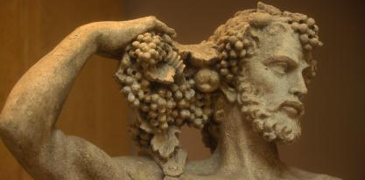
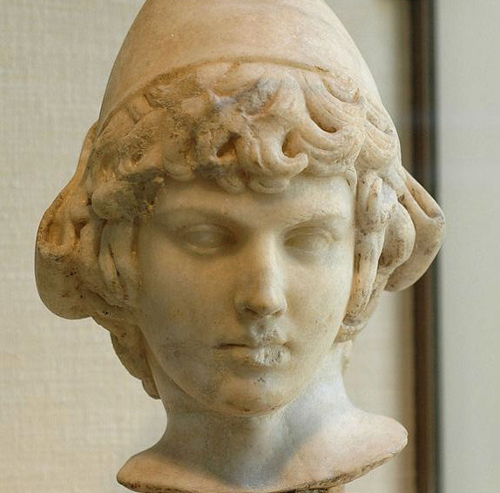
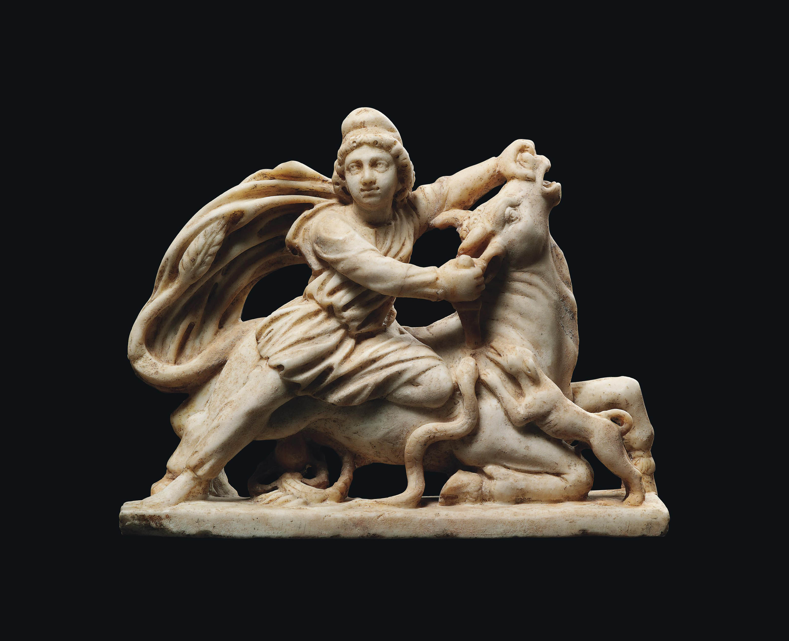
EASTER
Photo By: hipmonkey
There are several other pagan gods that are celebrated through Easter including Horus, Mithras, Attis, and Dionysus.
These pagan gods each reflect the resurrection of Christ in a different way and end with rebirth and start of spring.
As concerning therefore the eating of those things that are offered in sacrifice unto idols, we know that an idol is nothing in the world, and that there is none other God but one. For though there be that are called gods, whether in heaven or in earth, (as there be gods many, and lords many,) But to us there is but one God, the Father, of whom are all things, and we in him; and one Lord Jesus Christ, by whom are all things, and we by him.
- 1 Corinthians 8:4-6
From these verses we can see that the Bible constantly addresses idolatry, or the worship of false gods, stating that we are not to partake in it.
Therefore, when someone participates in Easter, they inadvertently partake in idolatry.
Photo By: Wikipedia
Photo By: Athanasian Reformed
Photo By: Christies

Slide 16
Valentine’s Day
Photo By: debbishdotcom

Slide 17
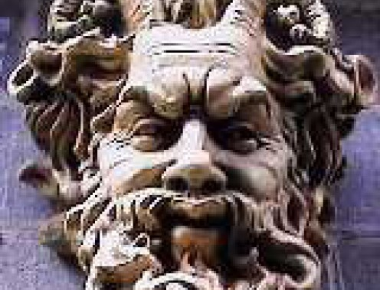
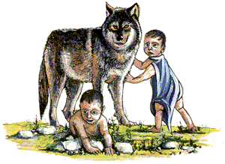
Valentine’s Day
Photo By: zhkis
The earliest origin of Valentine’s Day is the pagan holiday Lupercalia.
Lupercalia was a fertility festival dedicated to Faunus, the Roman god of agriculture and the founders of Rome, Romulus and Remus.
And it shall be, if thou do at all forget the LORD thy God, and walk after other gods, and serve them, and worship them, I testify against you this day that ye shall surely perish.
- Deuteronomy 8:19
Once again, we are told not to commit idolatry, or we will be punished.
Photo By:
Blogspot

Slide 18
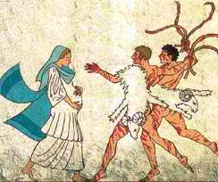
Valentine’s Day
As with the other pagan holidays, in celebrating Valentine’s Day, you celebrate its pagan roots of idolatry.
To begin the festival, members of the Luperci, a group of Roman priests gathered at a secret cave where the infants Romulus and Remus were believed to have been cared for by a she-wolf or lupa.
The priests would sacrifice a goat (for fertility) and a dog (for purification).
Then, they would strip the goat’s hide into strips, dip them into sacrificial blood, and go into the streets, gently slapping women and crop fields with the goat hide for fertility.
When thou art come into the land which the LORD thy God giveth thee, thou shalt not learn to do after the abominations of those nations.
- Deuteronomy 18:9
This scripture tells us that we are not to engage in the wicked practices of the people that we encounter.
So, although people no longer do these specific practices on Valentine’s Day, in celebrating the holiday, they celebrate its pagan origins.
Photo By: Grad School Jungle

Slide 19
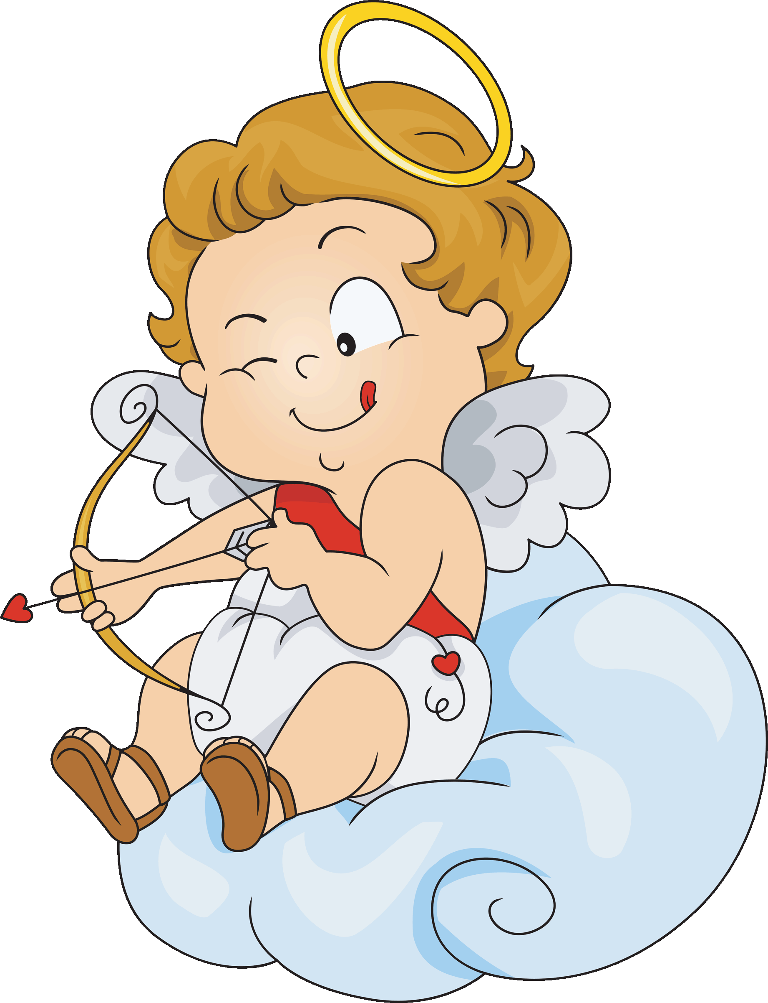
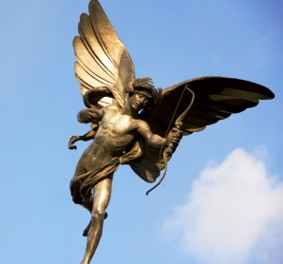
Valentine’s Day
Photo By: canukakiwistan
Photo By: Element Consultants
Roman women received the goat hides well because they wanted to become more fertile and later in the day, all the young women in the city would put their names in a large urn.
All the city’s bachelors would choose a name and become paired for the year with the chosen woman, and typically ended up marrying their match.
Cupid is a Roman god that is found in Greek mythology, the Greek god of love, Eros.
Greek poets wrote that Eros was a handsome immortal that used golden arrows to incite love and bad arrows to create hatred.
In the Hellenistic period, Cupid was depicted as a mischievous, chubby baby.

Slide 20
IN SUMMARY…

Slide 21
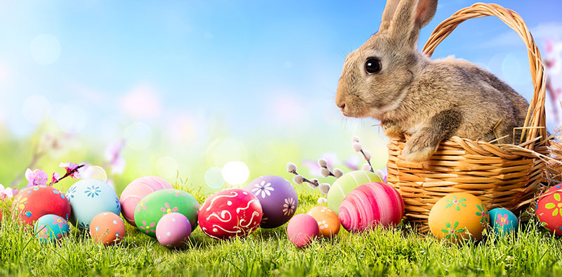
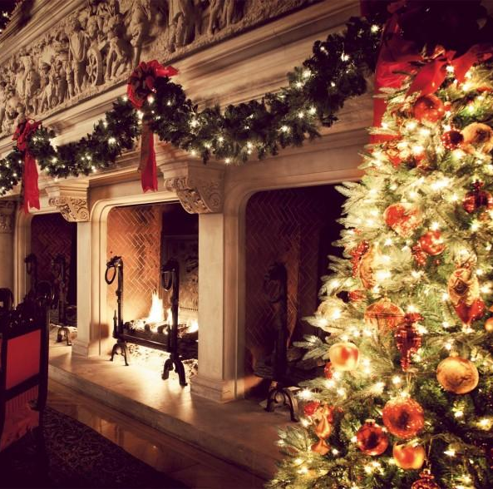
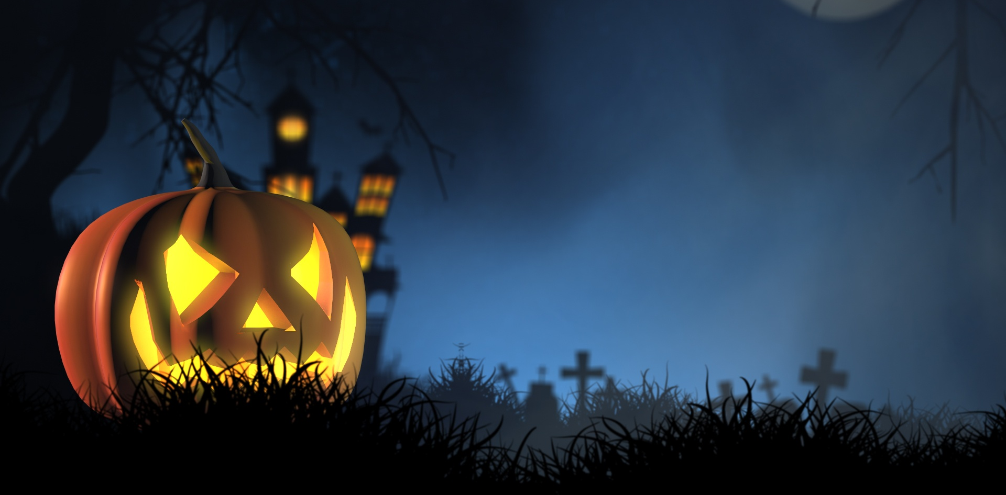
in summary
Photo By: Recruiter
In summary, there are several reasons as to why we should not celebrate pagan holidays like Christmas, Easter, Halloween, and Valentine’s Day.
All these popular holidays are surrounded by wicked origins and practices ranging from human sacrifice to homosexuality, to idolatry.
The practices involved in these holidays directly defy GOD’s commands to us.
GOD, our creator, does not want us to celebrate these pagan holidays.
It may be difficult to be separate from the many people that celebrate these pagan holidays, but that is precisely what GOD tells us to do.
If ye were of the world, the world would love his own: but because ye are not of the world, but I have chosen you out of the world, therefore the world hateth you.
- John 15:19
Photo By: Blogspot
Photo By: Founterior
Photo By:
PublicDomainPictures.net

Slide 22
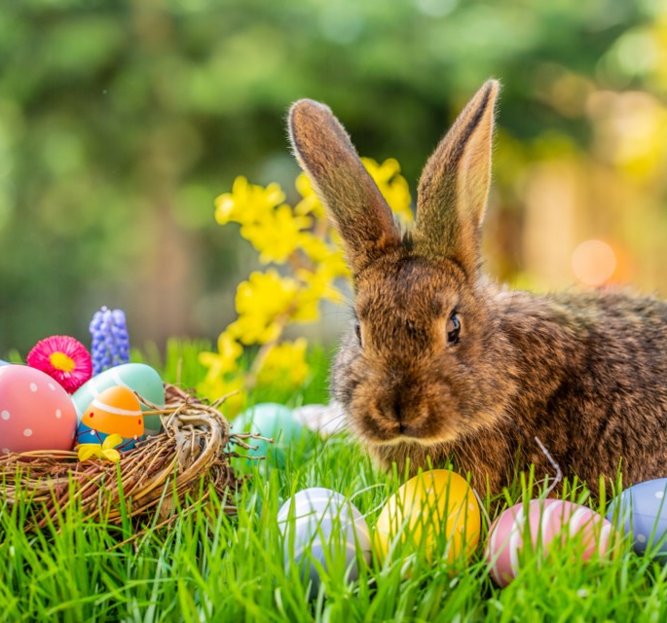
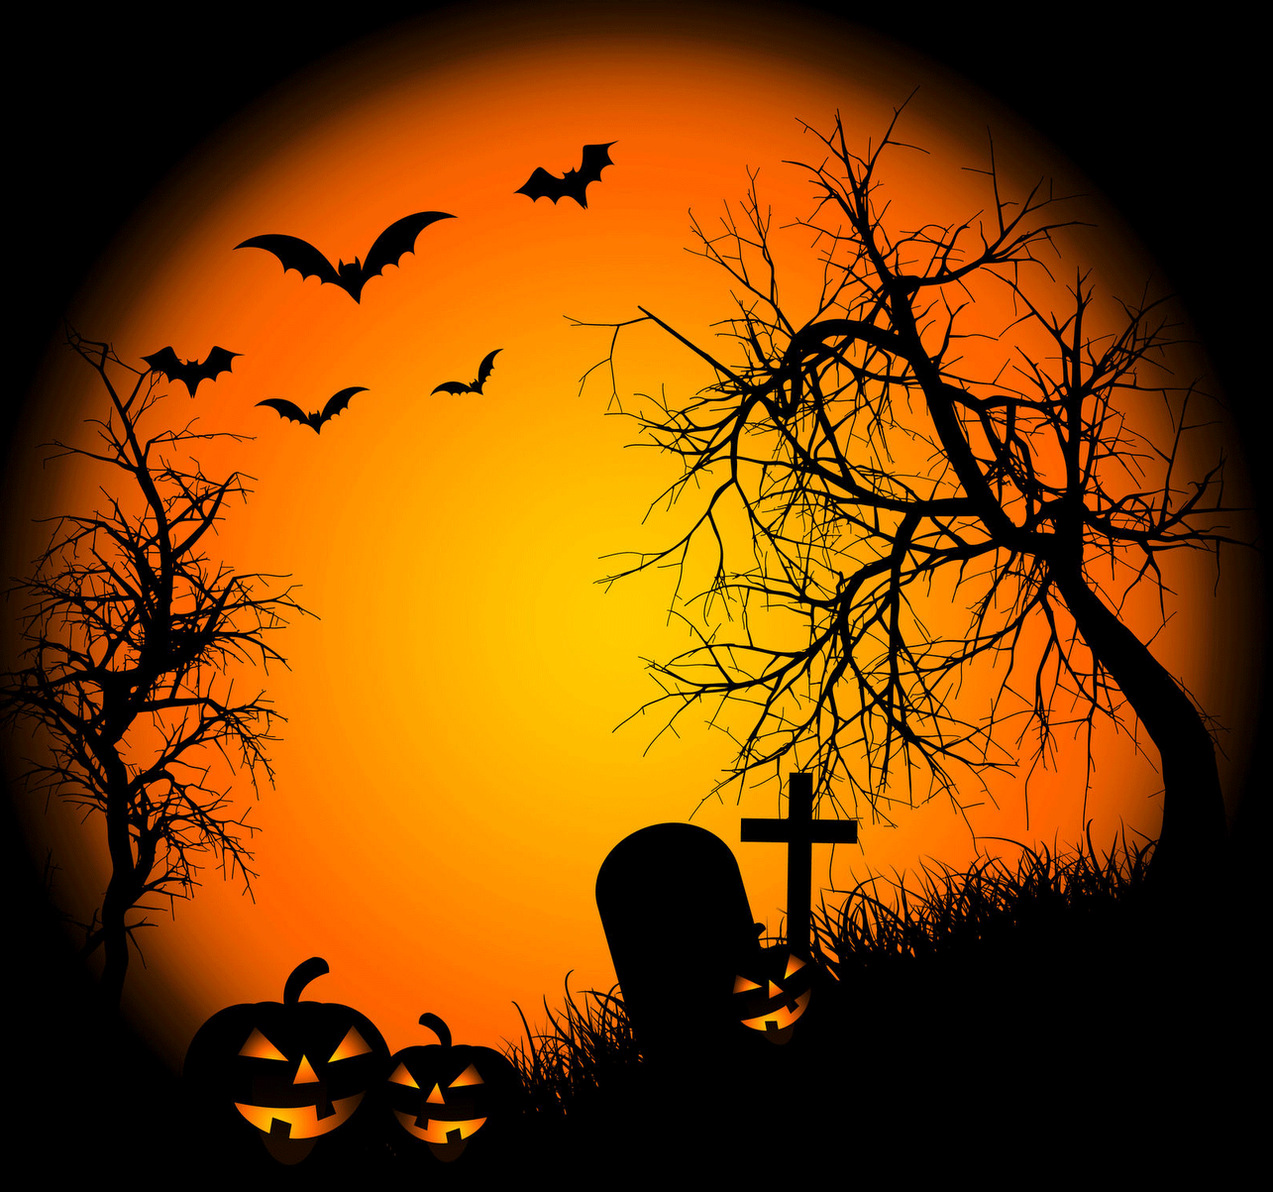
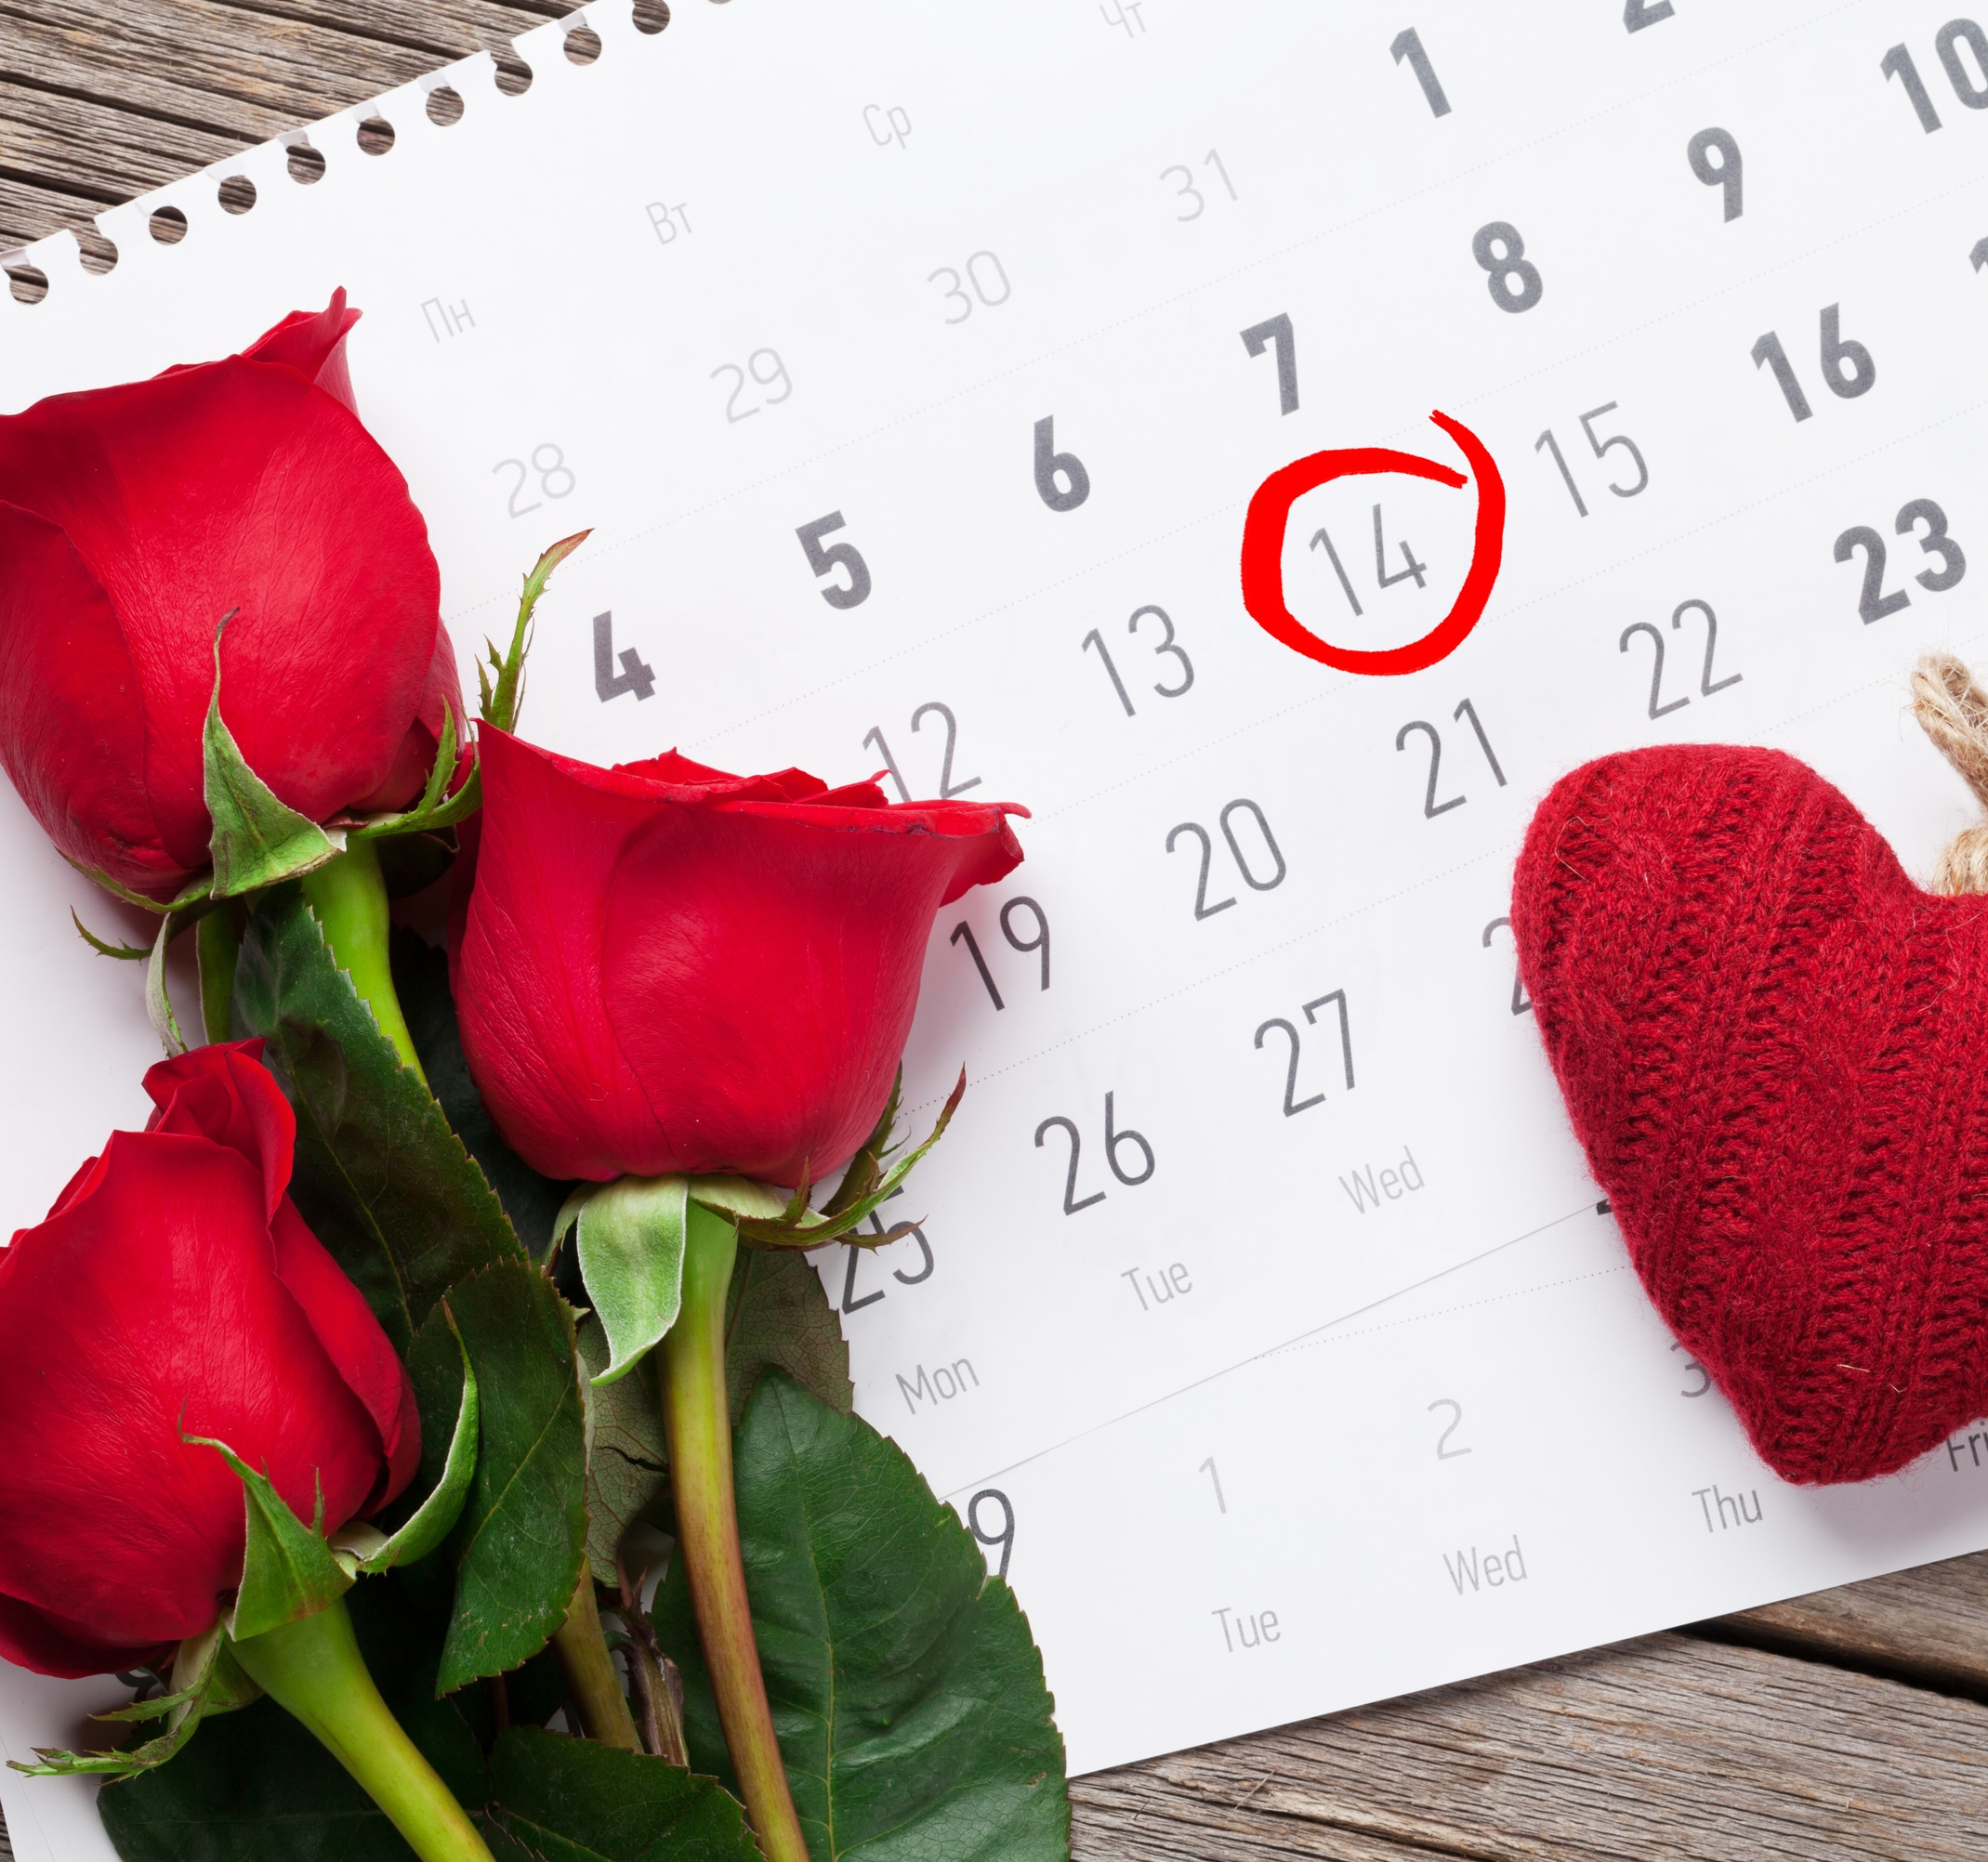
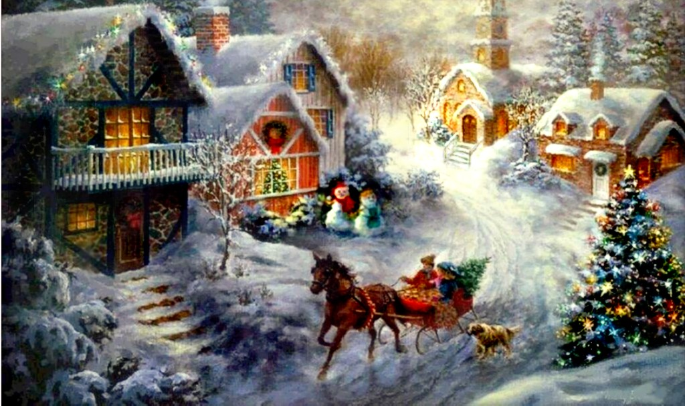
THE END
Photo By: CityNewsEverywhere
Photo By: Blogspot
Photo By: Money Crashers
Photo By: Walk The Tow Path

